Slide 1
CSci699 Software Forensics
Applying Software Engineering Practices

Slide 2
What Is Software Forensics
The science of analyzing code (source or binary) to determine whether IP infringement or theft occurred
Centerpiece of lawsuits, trials, and settlements
Disputes involving software patents, copyrights, and trade secrets
Software forensics tools are automated aids for comparing code to determine differences and correlations between software systems…
…and much more!

Slide 3
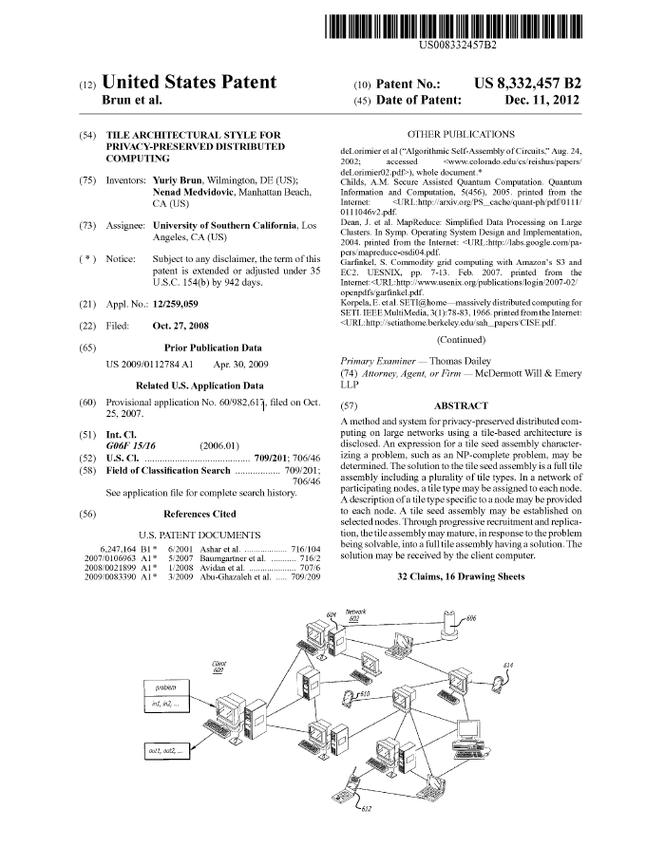
Software Forensics ☞ Software Engineering
Software forensics goes beyond code comparison
Forensics experts are very experienced software engineers
Huge amount of available information
Source code
Binaries
Technical documentation
Patents
Design artifacts
Standards
Similar systems
Websites
Datasheets
Marketing materials
Sworn testimony from system developers
…

Slide 4
Relevant Software Engineering Activities & Artifacts
Requirements
Specification
Architecture
Design
Analysis
Implementation
Reuse
Testing
Deployment
Maintenance
Evolution
Adaptation
Frameworks
Middleware
Cloud
Microservices
Generation
…but also obsolete technologies

Slide 5
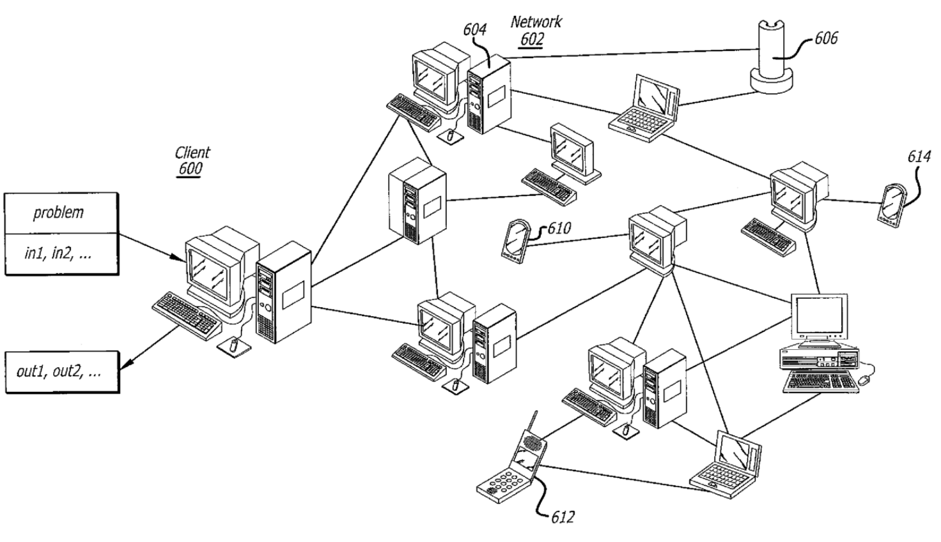
Concrete Patent
“Tile Architectural Style for Privacy-Preserved Distributed Computing”
US Patent 8,332,457
Inventors: Yuriy Brun and Nenad Medvidović
Asignee: USC
Filed: October 27, 2008

Slide 6
What Is the Patent About?
A method and system for privacy-preserved distributed computing on large networks using a tile-based architecture is disclosed. An expression for a tile seed assembly characterizing a problem, such as an NP-complete problem, may be determined. The solution to the tile seed assembly is a full tile assembly including a plurality of tile types. In a network of participating nodes, a tile type may be assigned to each node. A description of a tile type specific to a node may be provided to each node. A tile seed assembly may be established on selected nodes. Through progressive recruitment and replication, the tile assembly may mature, in response to the problem being solvable, into a full tile assembly having a solution. The solution may be received by the client computer.

Slide 7
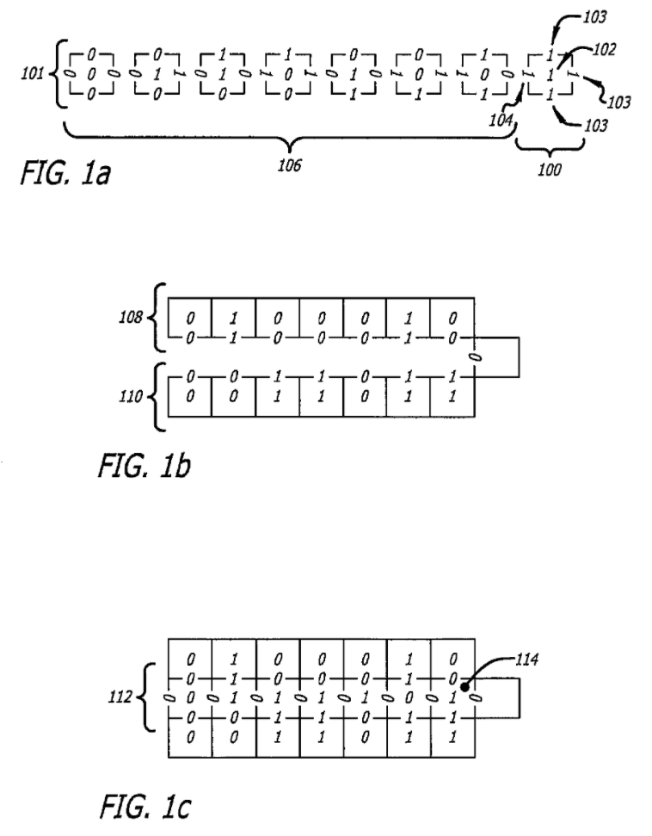
What Does This Mean in Practice?
34
61
27

Slide 8
Tile Assembly Model
A tile:
a square
labels on 4 sides
Tiles attach
when labels match
(Winfree 1998)

Slide 9
Tile Assembly Model
A tile:
a square
labels on 4 sides
Tiles attach
when labels match
(Winfree 1998)

Slide 10
Tile Interaction
Tiles can stick to assemblies:

Slide 11
Tile Interaction
Tiles can stick to assemblies:

Slide 12
Tiles Can:
Assemble
linear polymers
squares
arbitrary computable shapes
Count
Add
Multiply
Compute binomial coefficients
Emulate Turing machines
Factor
Solve NP-complete problems
SubsetSum
k-SAT
(Adleman et al. 2001)
(Rothemund et al. 2001, Adleman et al. 2001, 2002)
(Soloveichik et al. 2004)
(Winfree 1998, Moisset et al. 2005, Barish et al. 2005)
(Winfree 1998, Rothemund, 2004)
(Winfree 1998)

Slide 13
Distributed System

Slide 14
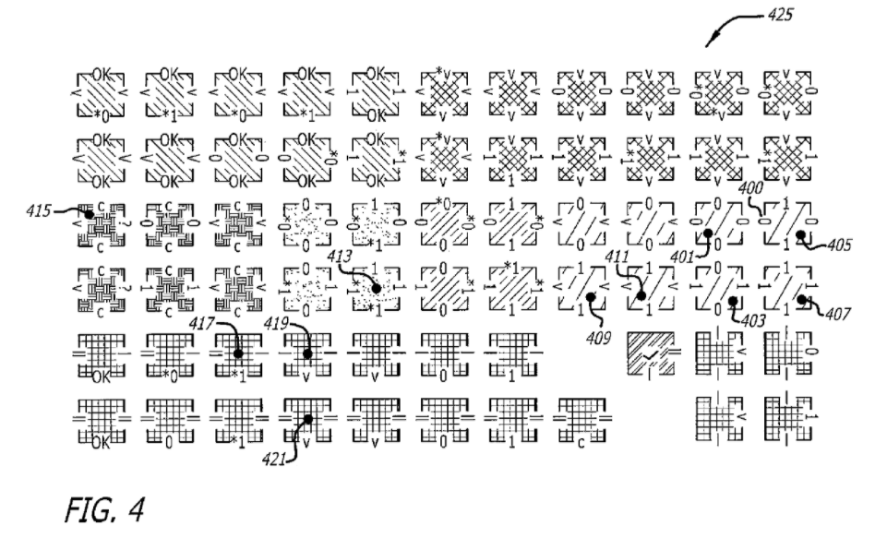
Solving Real Problems – Tile Types

Slide 15
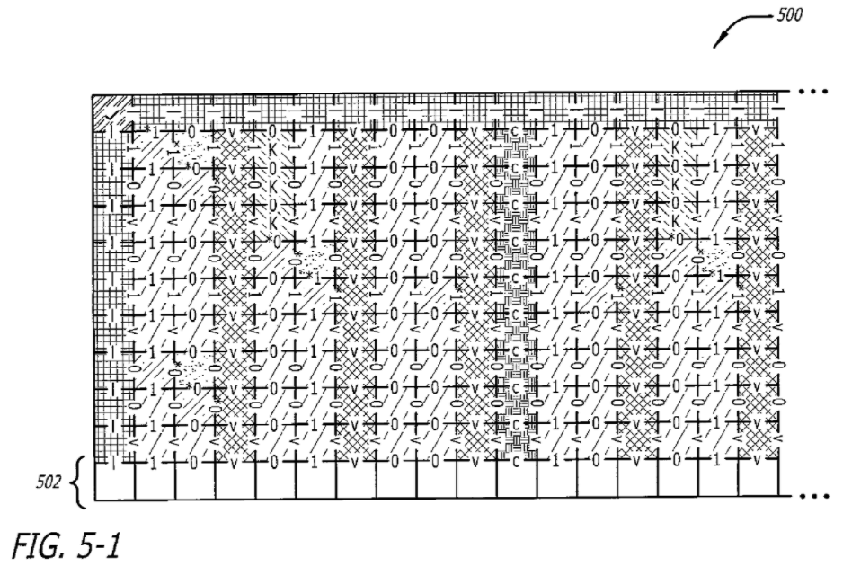
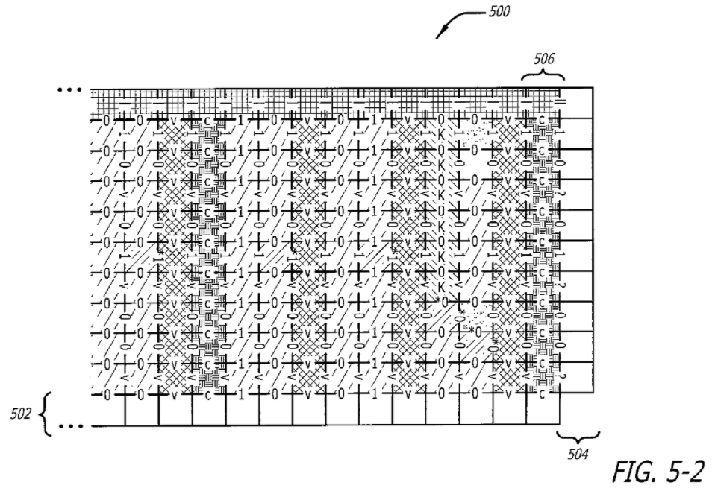
Solving Real Problems – Tile Assembly

Slide 16
Solving 3-SAT
(x₂∪¬x₁∪¬x₀)∩(¬x₂∪¬x₁∪¬x₀)∩(¬x₂∪x₁∪x₀)

Slide 17
Solving 3-SAT
(x₂∪¬x₁∪¬x₀)∩(¬x₂∪¬x₁∪¬x₀)∩(¬x₂∪x₁∪x₀)

Slide 18
Solving 3-SAT
(x₂∪¬x₁∪¬x₀)∩(¬x₂∪¬x₁∪¬x₀)∩(¬x₂∪x₁∪x₀)

Slide 19
How Factoring Works
Encode the input: 9991

Slide 20
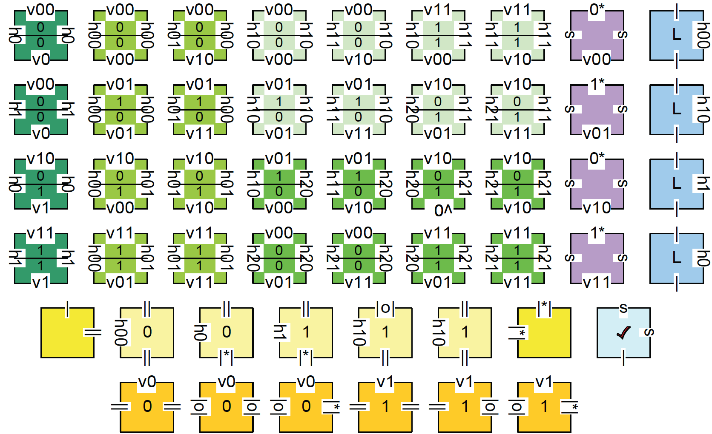
How Factoring Works
Copies of 50 tile types attach non-deterministically to guess factors

Slide 21
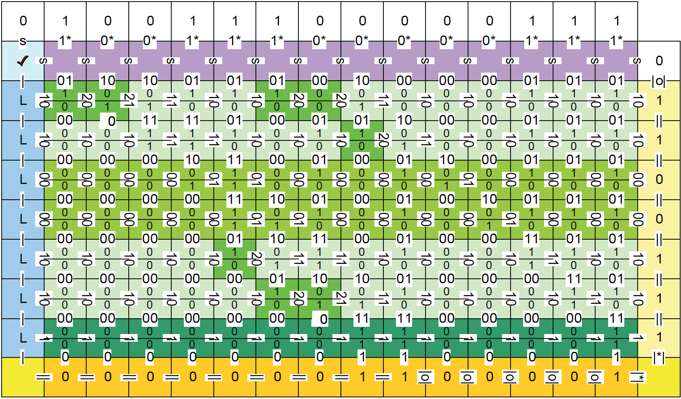
How Factoring Works
One of many copies of the input gets “lucky” and guesses 103×97

Slide 22
From Tile Assemblies to Distributed Systems
Convert a problem into a TAM crystal
Implement
tiles as software components
tile attachments as component references
Distribute the components on a network
Start with a single computation seed
The seed recruits two others, which recruit two more each…
Adhere to the architectural style that ensures privacy
No tile knows more than 2 bits of the computation
Each host may deploy one or more tile-components
No host can piece together the information in a meaningful way

Slide 23
Distributed System

Slide 24
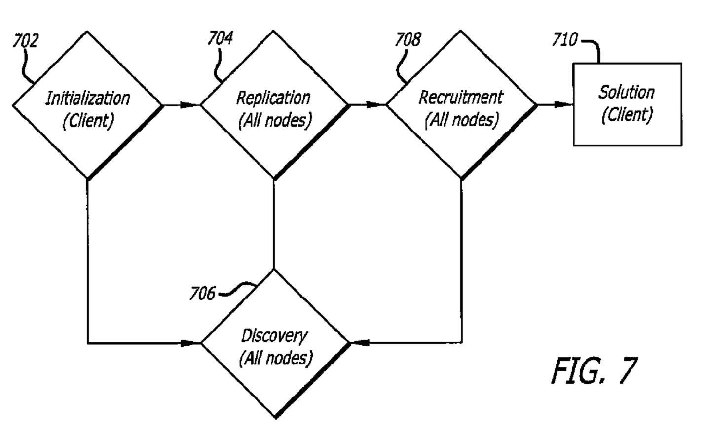
Key Process Steps

Slide 25
Replication

Slide 26
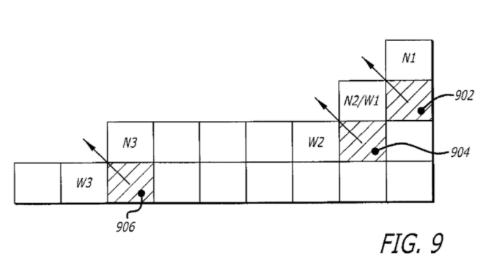
Recruitment

Slide 27
How Does sTile Work?
Realized as a framework – Mahjong
Constructed on top of USC’s Prism-MW platform
Implements all sTile algorithms
Initial deployment of a system representing the sTile crystal
Discovery and recruitment of additional network nodes
Replication of the computation
Comprises a prototype implementation and a simulation engine
Mahjong takes as input an NP-complete problem and outputs
A java program that can be deployed on a network, or
A simulation program with tunable parameters
https://people.cs.umass.edu/~brun/Mahjong/

Slide 28
Privacy Is Not Free
The cost of sTile’s privacy is efficiency
Compared to optimized non-private techniques, Mahjong delivers results slower
The “break-even” point is deployment on ≈4,000 computers
But!
Mahjong has not yet been optimized
It pushes privacy to the limit (no one knows more than 1–2 bits)
It can be made significantly more efficient
Mahjong does not require secure machines
“Getting lucky” with discovering private computation or data deployed with Mahjong is impossible
Discovering them via an orchestrated network attack is exponentially unlikely

Slide 29
Back to the Patent
Requirements
Specification
Architecture
Design
Analysis
Implementation
Reuse
Testing
Deployment
Maintenance
Evolution
Adaptation
Frameworks
Middleware
Cloud
Microservices
Generation
…but also obsolete technologies

Slide 30
Back to the Patent
Requirements
Specification
Architecture
Design
Analysis
Implementation
Reuse
Testing
Deployment
Maintenance
Evolution
Adaptation
Frameworks
Middleware
Cloud
Microservices
Generation
…but also obsolete technologies

