Slide 1
CSci699 Software Forensics
Software Copyright, Trade Secrets, and Patents Revisited
March 4, 2020

Slide 2
Different Types of Software IP
Copyrights
Trade secrets
Patents

Slide 3
Copyrights
Dictionary definition
Copyright is the exclusive legal right, given to an originator or an assignee to print, publish, perform, film, or record literary, artistic, or musical material, and to authorize others to do the same.
WIPO definition
Copyright is a legal term describing rights given to creators for their literary and artistic works, including computer software.
US Copyright Office
Copyright is a form of protection provided by the laws of the United States to the authors of “original works of authorship” that are fixed in a tangible form of expression.
An original work of authorship is a work that is independently created by a human author and possesses at least some minimal degree of creativity.
A work is “fixed” when it is captured in a sufficiently permanent medium such that the work can be perceived, reproduced, or communicated for more than a short time.

Slide 4
Software Copyrights
First submission from North American Aviation on November 30, 1961
Submitted on magnetic tape
Registered in June 1964
Two submissions from a Columbia University Law School student in April 20, 1964
One on magnetic tape, the other a printout
Registered in May 1964
Both registered under 1909 Copyright Act’s “rule of doubt”
2,000 programs registered before the 1976 Copyright Act
Ensured protections for the authors life + 70 years

Slide 5
Computer Software Copyright Act
Registered in 1980
Accounted for protecting trade secrets by redacting what is submitted
Requires only the first and last 25 pages to be submitted
Protects source, assembly, and object code
Allows protecting the UI
Submission as “literary work” or “visual arts work”
Courts have ruled that the following are copyrightable
Object code
Software embedded in a ROM
OS code

Slide 6
What Is and Isn’t Allowed
+ Fair use
Copies – backup, transfer to hard drive, transfer from hard drive to memory
Minor modifications/reconfigurations
– Reimplementation
– Minor changes to create your own version
+ Major changes that substantially advance a system
+ Reverse engineering
But watch out: This could have implications on patent infringement!

Slide 7
Software Trade Secrets
WIPO definition
Trade secrets are IP rights on confidential information which may be sold or licensed
Uniform Trade Secrets Act (UTSA) Definition
Information, including a formula, pattern, compilation, program device, method, technique, or process, that
derives independent economic value, actual or potential, from not being generally known to, and not being readily ascertainable by proper means by, other persons who can obtain economic value from its disclosure or use, and
is the subject of efforts that are reasonable under the circumstances to maintain its secrecy

Slide 8
More on Trade Secrets
IP refers to creations of the mind, such as
Inventions
Literary and artistic works
Designs
Symbols, names and images used in commerce
To qualify as a trade secret, the information must be
Commercially valuable because it is secret
Known only to a limited group of persons, and
Subject to reasonable steps taken by the rightful holder of the information to keep it secret
Unauthorized
acquisition,
use, or
disclosure
is a violation of trade secret protection

Slide 9
Software Trade Secrets
Unique algorithms
– Known algorithms cannot be trade secrets
+ Known algorithms used in ways that are not known can be trade secrets
– Open-source software cannot be a trade secret
+ New capabilities built on top of OSS can be a trade secret
Special organizations of the software
Unique code sequences

Slide 10
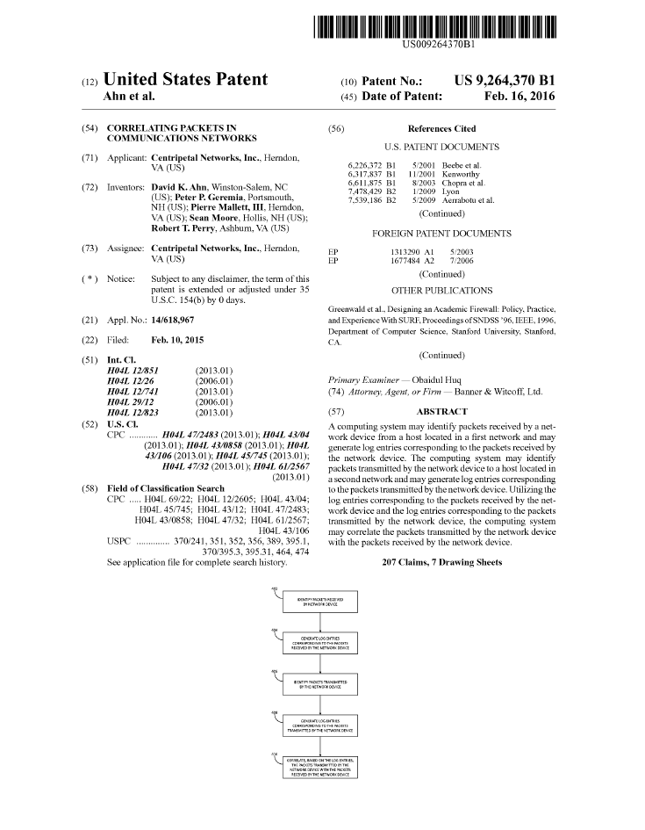
Software Patents
A patent for an invention is the grant of a property right to the inventor
The right granted by a patent excludes others from
making, using, offering for sale, or selling the invention in the US
importing the invention into the US
In the US, patents are issued by the USPTO
Generally valid for 20 years from the date of filing
a.k.a. patent’s “priority date”

Slide 11
What Makes Something Patentable
Novelty
With respect to what is known “in the art”
Comparison is not only to other patents
Utility
The threshold is typically low
Nonobviousness
To a POSITA (“person of ordinary skill in the art”)
For us, it may be a software engineer with several years of experience
One cannot patent an abstract idea

Slide 12
Three Types of Patents
Utility patents
granted to anyone who invents or discovers any new and useful process, machine, article of manufacture, or composition of matter
any new and useful improvement thereof
Design patents
granted to anyone who invents a new, original, and ornamental design for an article of manufacture
Plant patents
granted to anyone who invents or discovers and asexually reproduces any distinct and new variety of plant

Slide 13
Types of Patent Infringement
Direct
Your software does what my patent claims
Contributory
Your software is used by a third party, which in turn does what my patent claims
Induced
Someone can use your software only in a way that will infringe my patent
Divided
Two of you conspire to do what my patent claims

Slide 14
Elements of a Patent Infringement Case
Most cases have three principal elements
Infringement
Did one party practice what the other party has patented?
Validity
Should the patent have been issued in the first place?
But didn’t the USPTO examiner already go through this?
Damages
How much should the infringing party pay for a license?
Is the infringement accidental or willfull?

Slide 15
Activities in a Patent Infringement Case*
Infringement contentions
Claim construction
Markman hearing
Inter-partes review
Prior-art analysis
Other patents
Technical publications
Existing software systems
Document analysis
Public-domain documents
Marketing documents
Technical documents
Software Testing
May be UI testing only
Code analysis
Source code
Byte code
Binary code
Fact-witness depositions
Expert reports
Infringement
Validity
Damages
possibly others
Rebuttal reports
Expert depositions
Trial
Appeals
*An infringement case may include additional activities or only a subset of them; some activities may also take place in parallel and/or in a different order

Slide 16
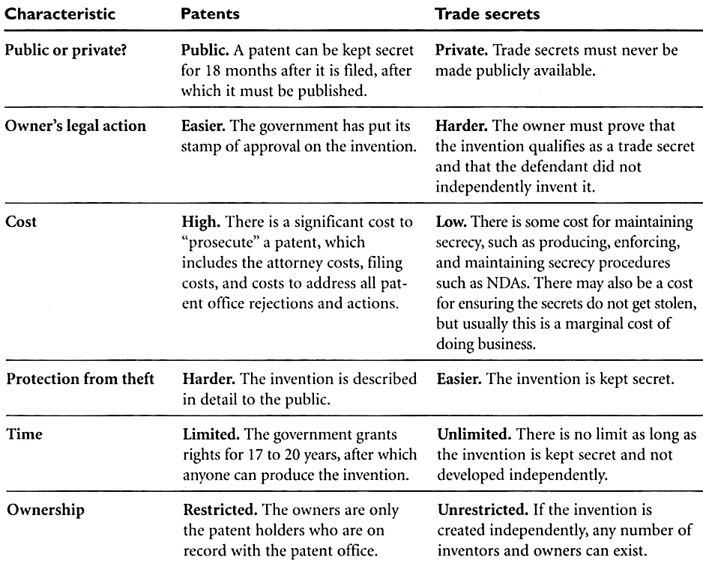
Protect Your IP with Trade Secret or Patent?

