Slide 1
CyBOK and Vulnerability Detection
Spring 2020
CSCI 699 – Software Forensics

Slide 2
Outline
The problem of Software Security
Definitions
CyBOK, Cybersecurity, Software Security
Vulnerabilities
Examples
Categories
Countermeasures
Vulnerabilities Detection
Static Detection
Dynamic Detection

Slide 3
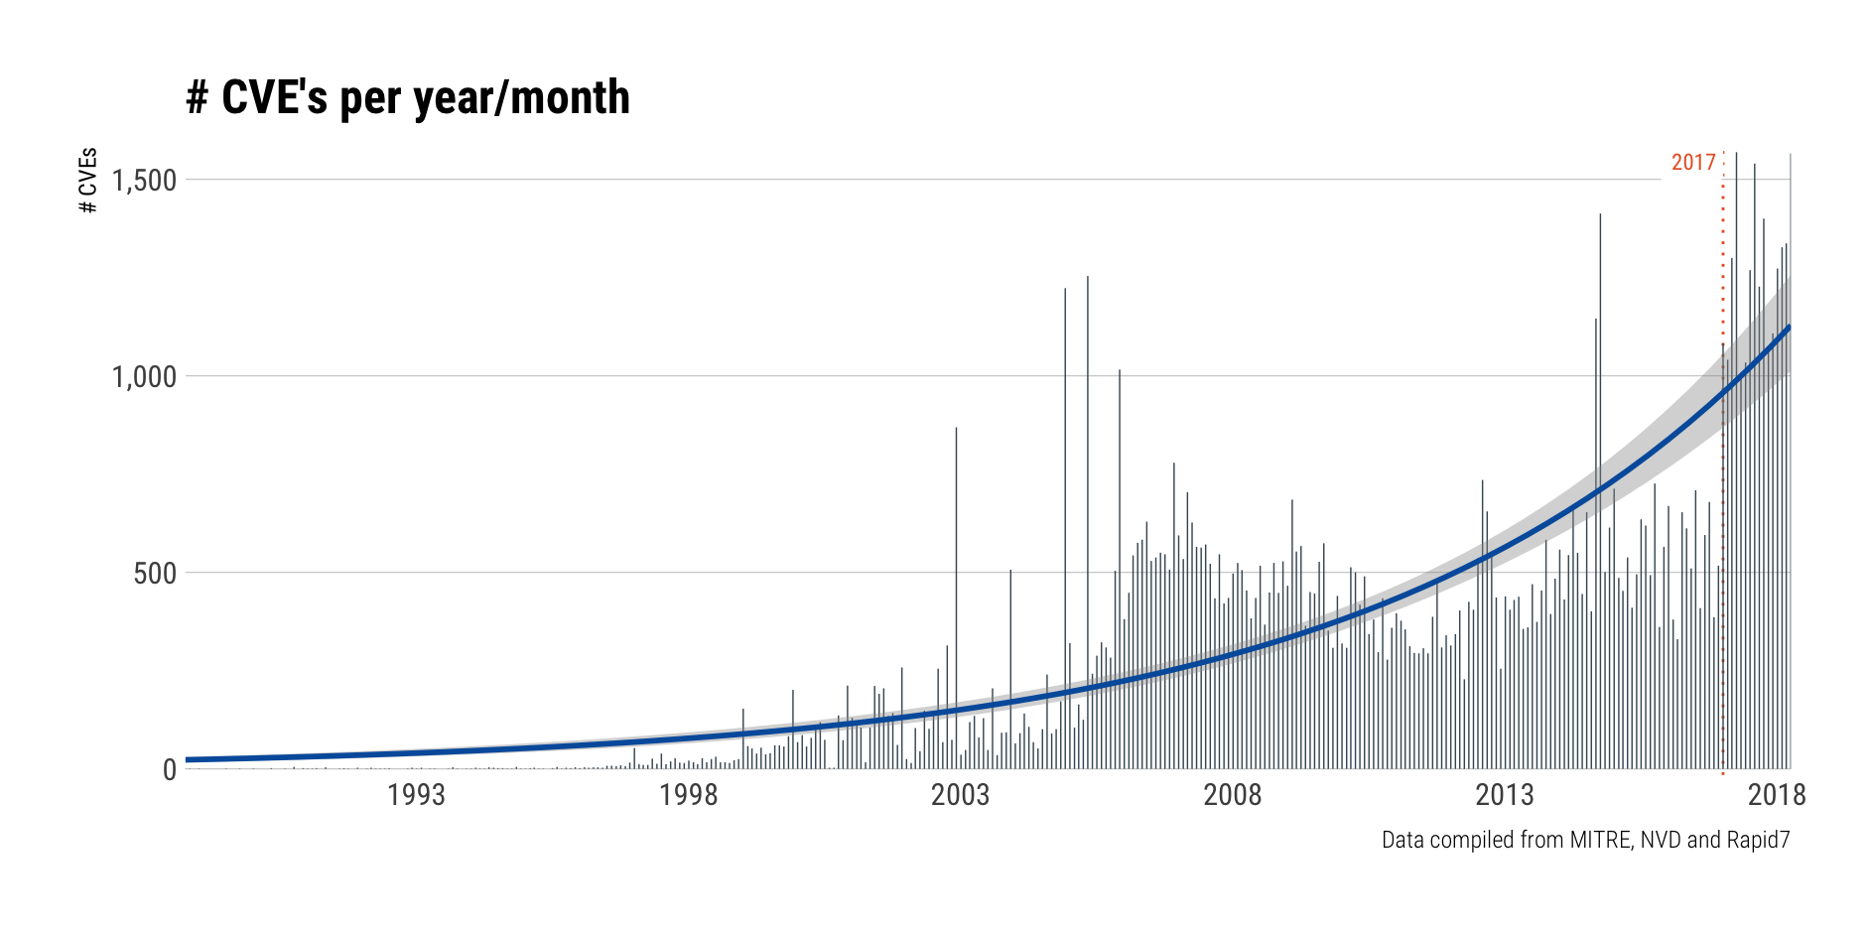
Vulnerabilities’ growth
Source: https://blog.rapid7.com/2018/04/30/cve-100k-by-the-numbers/
Notes:
Common Vulnerabilities and Exposures (CVE) is a catalog of known security threats.
CVE system provides a reference-method for publicly known information-security vulnerabilities and exposures.
The catalog is sponsored by the United States Department of Homeland Security (DHS).

Slide 4
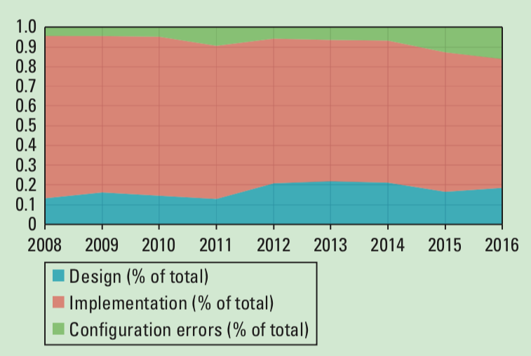
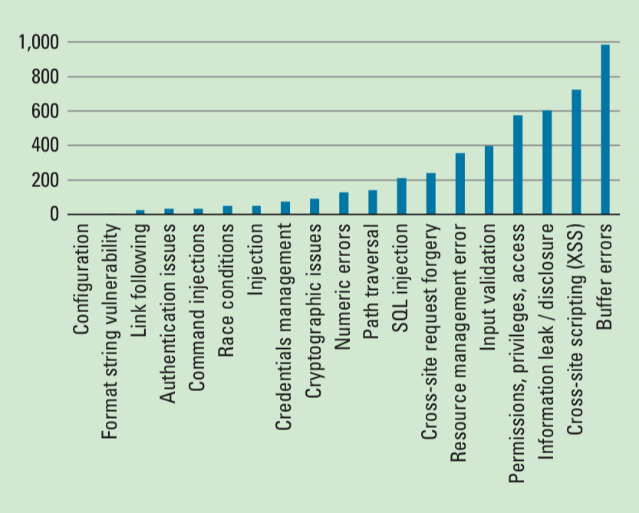
Source of Vulnerabilities
Based on the US National Vulnerabilities DB (NVD)
More than 85K publicly reported vulnerabilities
Distribution of Vulnerabilities in 2015
93% of buffer errors involved only a single condition
(typically, failure to check array bounds)
Source: [Kuhn, 2017]

Slide 5
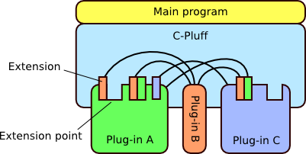
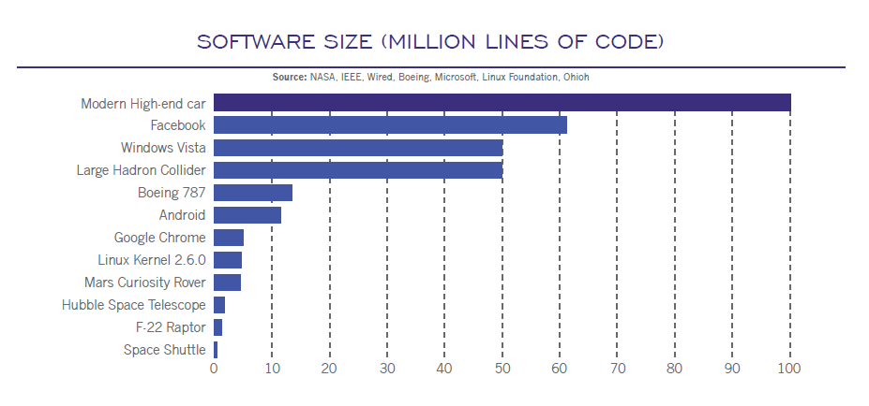
Why the problem is growing?
Connectivity
Extensibility
Complexity

Slide 6
CyBOK – Cybersecurity Book of Knowledge
Cybersecurity, computer security or IT security is the protection of computer systems from theft of or damage to their hardware, software or electronic data, as well as from disruption or misdirection of the services they provide. [Wikipedia]
Software Security
Software Security is the idea of engineering software that continues working under malicious attack.
[McGraw, 2004]
Source: [Rashid, 2019]

Slide 7
Software Security Issues
Security remains largely focused on post-development measures late in the SDLC
Vulnerabilities keep growing
Software is a central and critical aspect of the computer security problem
Many issues faced in computer security today are rooted in our approach to developing software and systems
Software defects have security ramifications
Malicious intruders can hack into systems by exploiting software defects
Security is an emergent property of a software system
There is no single addition that can make a software secure
Building secure software is better than protecting bad software

Slide 8
Software Security
Security objectives of a system include:
Confidentiality
Integrity
Availability
Vulnerabilities are causes of security failures, which prevent the system to achieve its security objectives
Software vulnerabilities or implementation vulnerabilities -> known classes of bugs that enable specific attack techniques
Software Security is about avoiding Software Vulnerabilities

Slide 9
Buffer Overflow
Example:
> Enter the password :
> hhhhhhhhhhhhhhhhhhhh
> Wrong Password
> Root privileges given to the user
The attacker supplied an input of length greater than what buffer can hold, overwriting the memory of the integer variable ‘pass’. The value of ‘pass’ became non-zero and hence root privileges were granted to the attacker.
Source: https://www.thegeekstuff.com/2013/06/buffer-overflow/?utm_source=feedly

Slide 10
SQL injection
Programmer constructs the SQL query as:
query = "select * from users where name=’" + name +"’ and pw = ’" + password + "’"
The name string is provided by the attacker as:
"John’ --"
This would remove the password check from the query, because ‘--’ starts a comment in SQL
query = "select * from users where name=’John’ --’ and pw = ’’”

Slide 11
Categories of Vulnerabilities
Memory Management Vulnerabilities
Attacks exploit invalid access to memory
Ex.: Buffer overflow
Structured Output Generation Vulnerabilities
Attacks exploit the construction of unintended output
Ex.: SQL injection
Race Condition Vulnerabilities
Attacks exploit timing of actions to influence behavior of the program
API Vulnerabilities
Attacks exploit error-states caused by contract violations
Side-channel Vulnerabilities
Attacks exploit power consumption, execution time or lower abstraction layer to leak information or induce faults

Slide 12
Countermeasures
Prevention
Safe programming languages, APIs,
Detection
Security code reviews,
Security testing,
Mitigation
Runtime monitoring
Secure coding standards, etc.
Penetration testing, etc.
Automates software diversity, etc.
Static code analysis,
Prevent vulnerabilities from being introduced:
Detect vulnerabilities in project artifacts during development
Mitigate impact at runtime

Slide 13
Vulnerabilities and Countermeasures

Slide 14
Countermeasures
Prevention
Safe programming languages, APIs,
Detection
Security code reviews,
Security testing,
Mitigation
Runtime monitoring
Secure coding standards, etc.
Penetration testing, etc.
Automates software diversity, etc.
Static code analysis,

Slide 15
Detection of Vulnerabilities
Properties for detection techniques:
Sound: if it can correctly conclude that a given program has no vulnerabilities of that category (no false negatives)
Requires reasoning about all executions (usually infinite)
Static checking of the program code
Complete: if the vulnerabilities it finds are actual vulnerabilities (no false positives)
Executions of a program that make vulnerabilities evident
Dynamic checking of the program code
Rice’s theorem: no detection technique can be both sound and complete
Detection tools can use a hybrid combination of static and dynamic analysis to achieve a trade-off between soundness and completeness
Manual code review and testing are also important detection techniques

Slide 16
AST – Application Security Testing
Source: [Scanlon, 2018]

Slide 17
Static Detection
Analyze source code or binary code
SAST: Static Application Security Testing
Advantages:
Can operate on incomplete code
A single analysis can attempt to cover all possible program executions
Problem: false positives
Classes of techniques:
Heuristic static detection
Sound static detection

Slide 18
Heuristic Static Detection
Detect violations of secure programming-practice heuristics
“Do not use this dangerous API function”
“Only use this API function with a constant string as first parameter”
Violations are flagged based on a semantic model (AST, abstractions of data flow, control flow)
Taint analysis (flow analysis):
Input values (taint sources) that can influence values used in risky operations (restricted sink)
Detect confidential or sensitive information that flows to public output channels
Taint can be removed from values that were processed in sanitization functions (reducing the number of false positives)
Manual effort is required to configure the right sets of sources, sinks, and sanitizers

Slide 19
Sound Static Verification
Techniques that are sound (no false negatives) for well-defined categories of vulnerabilities
Challenge: express specification formally (violations of the specification lead to vulnerabilities)
Techniques:
Program verification: to construct a proof that covers all program executions
Abstract interpretation: to map run-time values from the concrete program to finite abstract domains (to prove absence of memory management vulnerabilities, for example)
Model checking: to exhaustively explore all reachable states of the program to check for violations

Slide 20
Dynamic Detection
Techniques that execute a program and monitor the execution to detect vulnerabilities
DAST: Dynamic Application Security Testing
If efficient, can also be used during run-time (mitigation)
Aspects:
Monitoring: how to monitor execution to detect vulnerabilities?
Generating relevant executions: how many and which input values should be monitored?

Slide 21
Monitoring
When a vulnerability is a violation of a specific property, such violation can be monitored
Examples of monitors:
For memory management vulnerabilities: C compilers that include options to generate code that allows to monitor these vulnerabilities
For structured output generation vulnerabilities: tools that track the flow of untrusted input strings
For API vulnerabilities: assertions, pre-conditions and post-conditions compiled into code to monitor vulnerabilities at testing time

Slide 22
Generating relevant executions
Select appropriate inputs that generate executions of the program that lead to the discovery of new vulnerabilities
Fuzz testing or fuzzing techniques:
Black-box fuzzing:
Input values generated based on the input/output behavior of the program
Variants: purely random testing, model-based fuzzing, mutation-based fuzzing
White-box fuzzing:
Input values generated taking into account the internal structure of the program
Dynamic symbolic execution is the main technique

Slide 23
Gartner Magic Quadrant for AST

Slide 24
Key Takeaways
Software defects have security ramifications, making software vulnerable to attacks
There are many forms of software implementation vulnerabilities:
Memory management vulnerabilities, Structure output generation vulnerabilities, Race condition vulnerabilities, Side channel vulnerabilities, etc.
There is a wide range of countermeasures:
Prevention
Detection
Static detection
Dynamic detection
Mitigation
No detection technique can be both sound and complete -> trade-offs

Slide 25
References
Frank Piessens, 2018. CyBoK Software Security Lifecycle Area Issue 1.0.
Kuhn, M. Raunak, and R. Kacker, “It Doesn’t Have to Be Like This: Cybersecurity Vulnerability Trends,” IT Professional, vol. 19, no. 6, pp. 66–70, Nov. 2017.
McGraw, G., 2004. Software security. IEEE Security Privacy 2, 80–83. https://doi.org/10.1109/MSECP.2004.1281254
Rashid, A., Chivers, H., Danezis, G., Lupu, E., Martin, A., 2019. The Cyber Security Body of Knowledge.
Thomas Scanlon, 2018. 10 Types of Application Security Testing Tools: When and How to Use Them [WWW Document]. SEI Blog. URL https://insights.sei.cmu.edu/sei_blog/2018/07/10-types-of-application-security-testing-tools-when-and-how-to-use-them.html (accessed 3.31.20).

