Slide 1
CSci699 Software Forensics
Detecting (1) Copyright Infringement (2) Patent Infringement (3) Trade Secret Theft

Slide 2
Detecting Copyright Infringement
Code is rarely copied verbatim
Frequent modifications - of any code
To introduce/change features
To hide detection
Many possible reasons for correlation
Third-party source code
Code generation tools
Commonly used elements
Common algorithms
Common author
Copying (plagiarism, copyright infringement)

Slide 3
Third-Party Source Code
Certain code can be used in many programs
OSS is freely and widely available
E.g., Android, Java, Apache
Third-party libraries can be purchased
E.g., domain-specific software

Slide 4
Code Generation Tools
Use similar identifiers
Variables
Classes
Methods
Properties
…
Rely on templates
Results in shared patterns

Slide 5
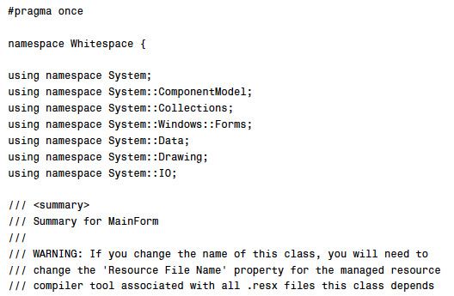
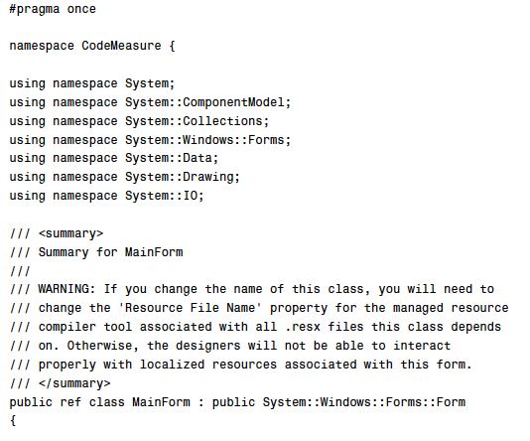
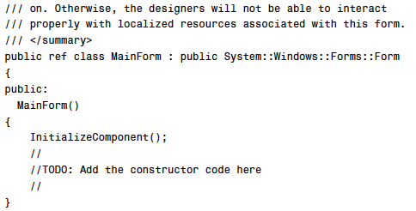
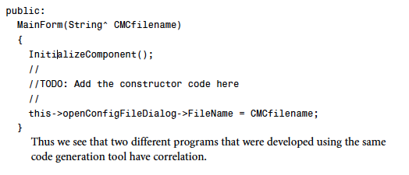
C++ Code for a Standard Windows Form in Visual Studio

Slide 6
Commonly Used Elements
Universally taught terms and concepts
Initialize, iterate, terminate, pointer, field, null…
Commonly used identifiers
result, count, main…
Commonly used abbreviations and acronyms
obj, ptr, hw, sw…
OSS, PLA, SOC, IOT, SDK, IDE…
Commonly used statements
(i=0; i<N; i++)
Domain-specific concepts
Credit, debit, transfer, interest
Takeoff, landing, roll, pitch, yaw, descent
Activity, fragment, service, content provider, broadcast receiver
Course, section, assignment, announcement, tool, grade

Slide 7
Common Algorithm
Many trivial algorithms are commonly (re)used
E.g., sort, binary search
More complex algorithms have known implementations
E.g., hashing functions
https://www.movable-type.co.uk/scripts/sha256.html
Systems that deal with real-world phenomena share underlying science
Domain-specific concepts → domain-specific algorithms

Slide 8
Common Author
Coding style
Individual
Organizational
Commenting practices
Detailed vs. brief comments
Class/file summaries
Constructing and formatting identifiers
Class and method sizes and structures
File and directory organization

Slide 9
Copying
None of the above ☞ copying/plagiarism
What about design copying?
Styles
Patterns
PLAs / DSSAs
Frameworks / standards
Reference architectures
Concrete architectures

Slide 10
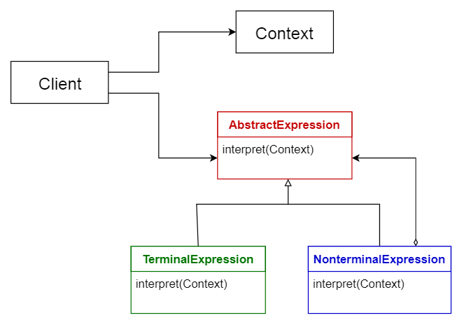
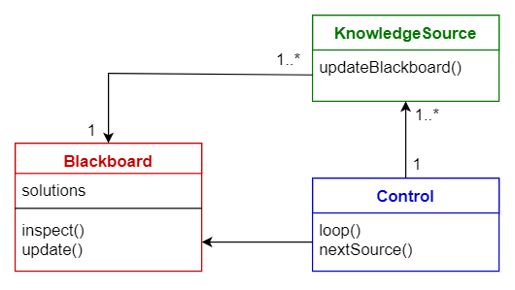
Patterns / Styles

Slide 11
PLAs / DSSAs
If they are widely known ☞ lower likelihood of copying
E.g., Android
If they are proprietary ☞ suspicious
E.g., Android-based reservation systems

Slide 12
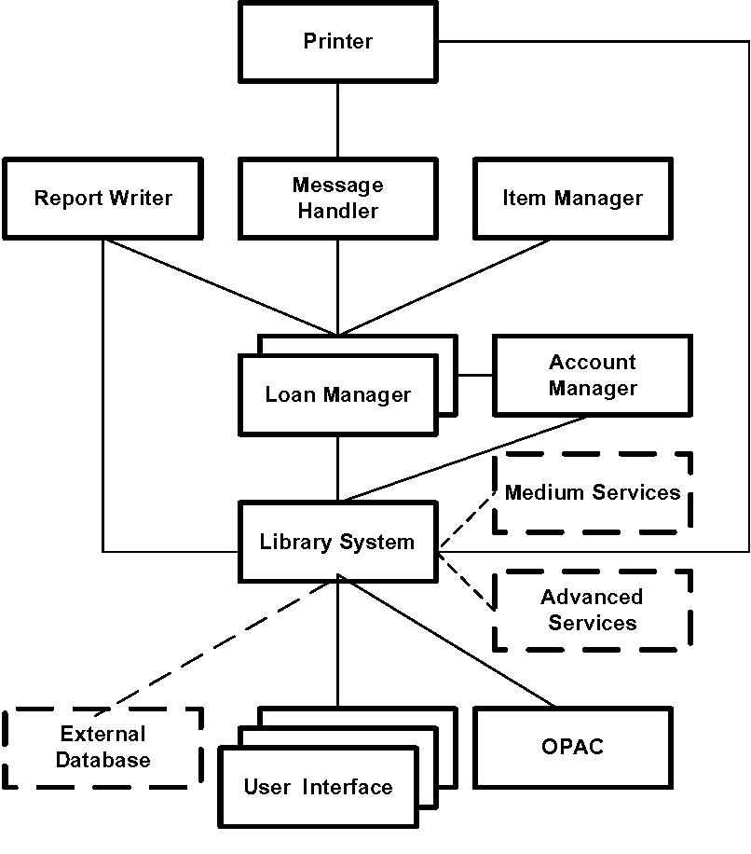
Example PLA

Slide 13
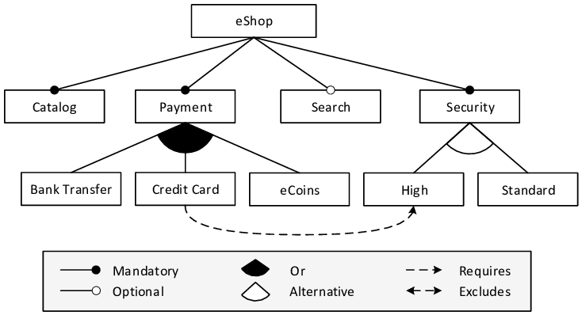
Example PLA

Slide 14
Example PLA

Slide 15
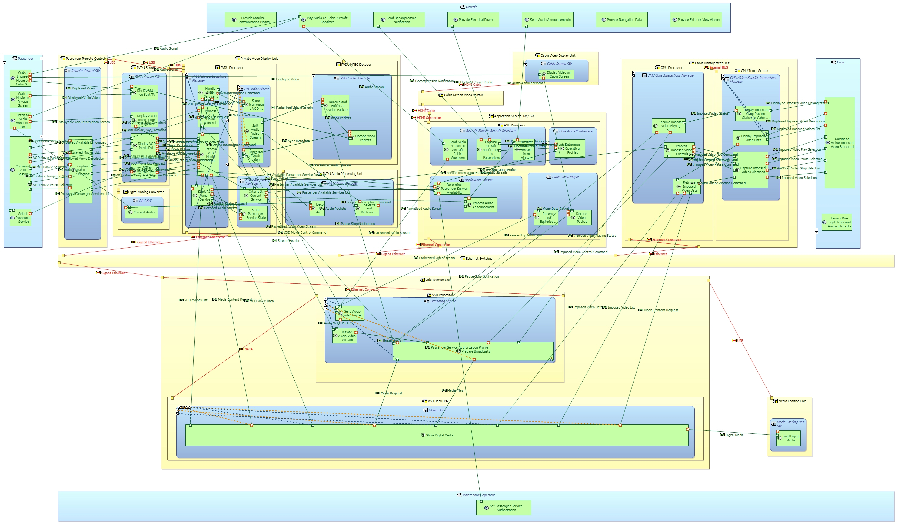
Example PLA

Slide 16
Framework

Slide 17
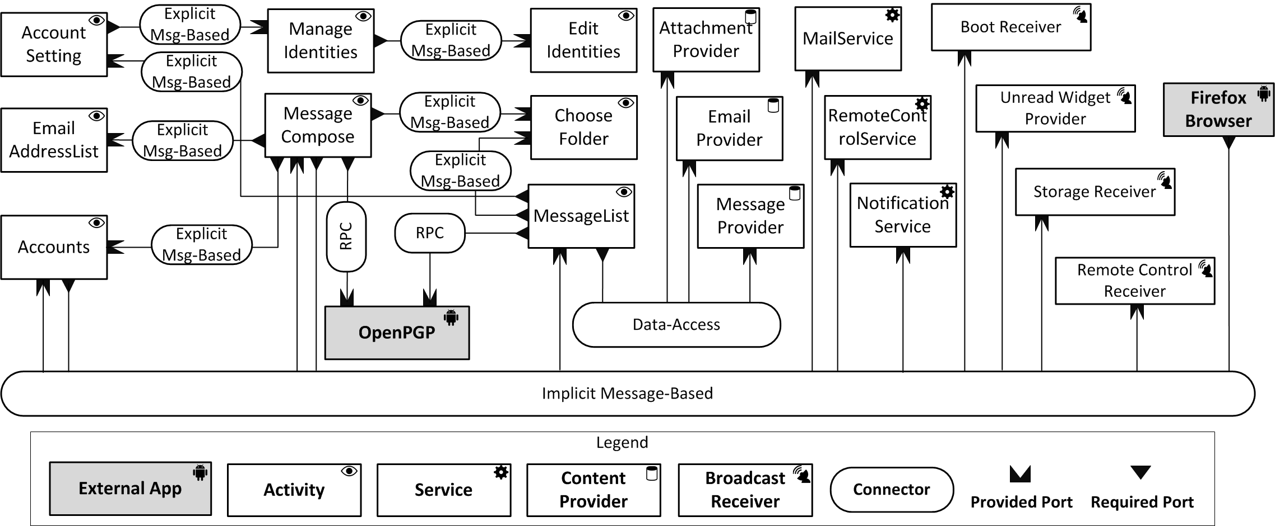
Concrete Architecture

Slide 18
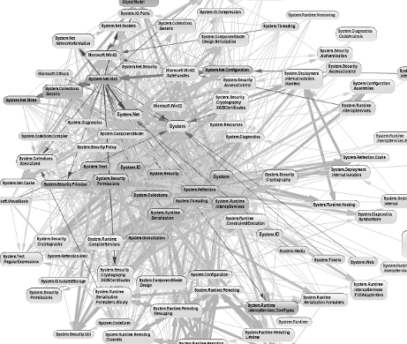
Big Ball of Mud

Slide 19
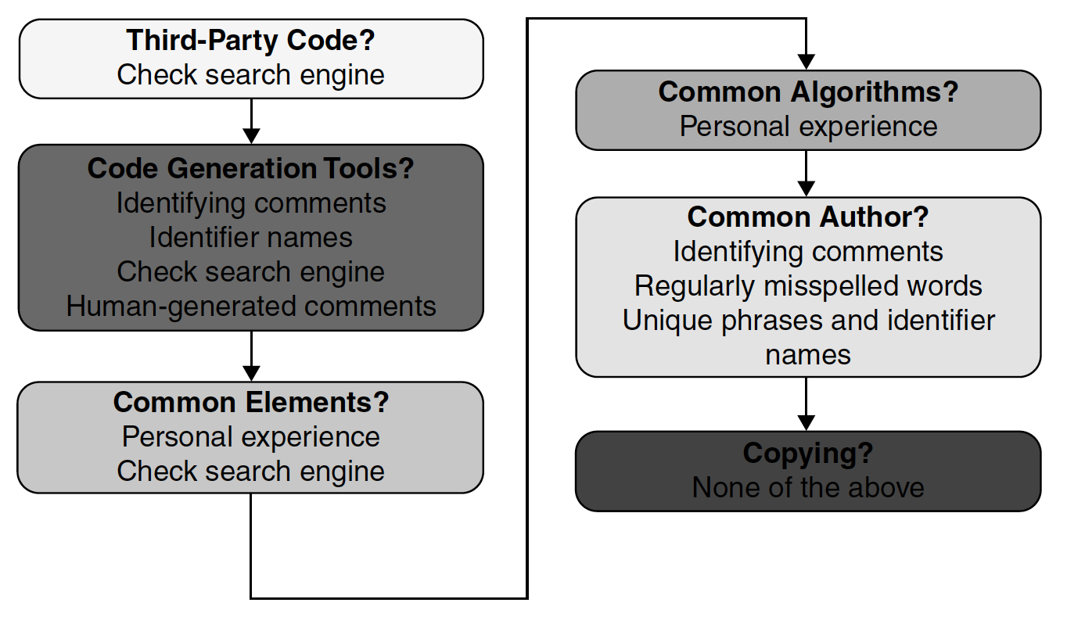
Detecting Copying

Slide 20
Detect Third-Party Code
Just Google it!
Lots and lots of code out there
If you don’t find it ☞ it’s been copied
Open-source DB search is more limited
Even rare / “hidden” code is likely to be indexed by Google
COTS won’t show up on either
User guides might
Tools that can aid with this
E.g., SourceDetective by S.A.F.E. corp
Allows automated filtering of “false positives”
Ultimately, manual inspection is required

Slide 21
Detect CodeGen
Unusual patterns in variable names
E.g., C_ASSERT_H_3803b949_b422_4377_8713_ce606f29d546
Google for it
People are likely to have posted snippets
Hints in comments
The code may say it’s automatically generated
Too much overlap may be due to copying
How much do you automatically generate?
What parameters do you supply?

Slide 22
Detect Common Elements
Be sure to account for standards
Caution: that only goes so far
Atypical code “elements”
Whitespace
Indentation
Filenames
Directory names
Directory structures

Slide 23
Detect Common Algorithms
Googling is a first step
Can be “fooled” with (simple) obfuscation
Must rely on program analysis
AST
CFG
DFG
PDG
Requires more sophisticated approaches
E.g., graph matching/similarity

Slide 24
CFG Example

Slide 25
PDG Example

Slide 26
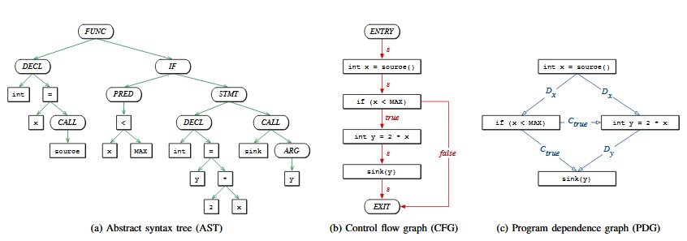
Example Code Snippet
void foo() {
int x = source();
if( x < MAX ) {
int y = 2*x;
sink(y);
}
}

Slide 27
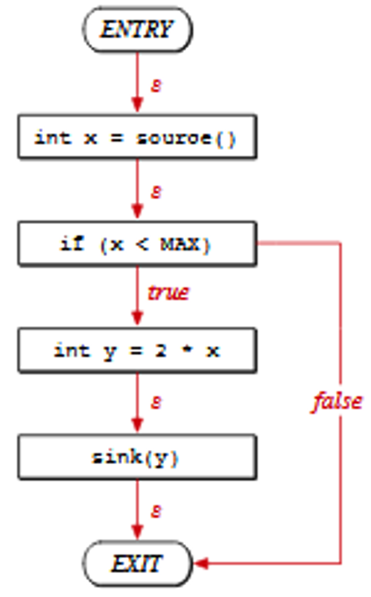
Obfuscated Snippet
void foo() {
int x = source();
if( x < MAX ) {
int y = 2*x;
sink(y);
}
}
void boo() {
int x;
x = lollipop(); int y = x;
int MIN = MAX;
if( MIN >= y+1 ) {
int a = x+y;
printf(“before \n”);
int w = a+MIN-MAX;
candy(w);
printf(“after \n”);
}
}

Slide 28
Obfuscated Code Metrics
N-gram
Counts frequency of ASCII code occurrences within a string
Particular focus on special characters
Entropy
Measures byte distribution within a string
Particular focus on special characters
Wordsize
Longer statements have a higher probability of being obfuscated

Slide 29
Detect Common Author
Incidental correlation
Personal coding and commenting style
Preference for certain functions/instructions
Preference for certain phrases
Spelling, punctuation, grammar
Don’t discard this off the bat

Slide 30
OK, So There’s Copying
Copying need not be infringement
Did you have right to copy?
Was the copying substantial?
Is the original code creative?
Relevant factors
Relevant circumstances
Functionality that was copied
Difficulty of recreating from scratch
Importance of the code

Slide 31
Right to Copy
If you own the copyright
Copying is for fair use
You were given the authority of the owner

Slide 32
Substantial Copying
One measure is the fraction of copied code
Is this a good argument?
Another measure is the importance of the copied code
How do you determine this?
Complexity
Function points
Difficulty of recreating from scratch

Slide 33
Code → Creative Works
Only creative works are subject to copyright
Gray area
Is this creative?
void foo() {
int x = source();
if( x < MAX ) {
int y = 2*x;
sink(y);
}
}

Slide 34
Example Copyright Infringement Case (1)
Computer Associates International Inc. v. Altai Inc. (1992)
CA’s OS-level job scheduling program
CA Scheduler
Sorts, executes, and controls jobs submitted to a computer
Written for IBM System 370
Running on three OSs: DOS/VSE, MVS, VM/CMS
CA Scheduler’s Adapter interfaces with all three Oss
Altai’s OS scheduler
Zeke for MVS
OSCAR 3.4 performs the same operation as CA’s Adapter

Slide 35
Example Copyright Infringement Case (2)
Altai’s OS scheduler
Zeke for MVS
OSCAR 3.4 performs the same operation as CA’s Adapter
OSCAR 3.4 was implemented by a former CA employee
Infringes
CA sued Altai for copyright infringement
Altai threw out OSCAR 3.4
Clean-room implementation of OSCAR 3.5
Does not infringe

Slide 36
Example Copyright Infringement Case (3)
CA claimed non-literal infringement
Code is not the same but underlying idea is
Appellate court created a test for “substantial similarity”
Abstraction-filtration-comparison test
Abstract the code into a higher-level representation
Filter out protectable from non-protectable elements
Known optimization techniques
OS interfacing functionality
Open-source functionality
Compare the abstract, filtered functions

Slide 37
A-F-C Test in CodeSuite
Abstraction
Extracts instruction sequences
E.g., if (x > y) is considered the same as if (sqrt(abc) + len(xyx) == 3.1415926)
Filtration
Allows user to specify non-protectable code
Allows SourceDetective to filter out elements found on the Internet
Comparison
Simple side-by-side analysis of instruction sequences

Slide 38
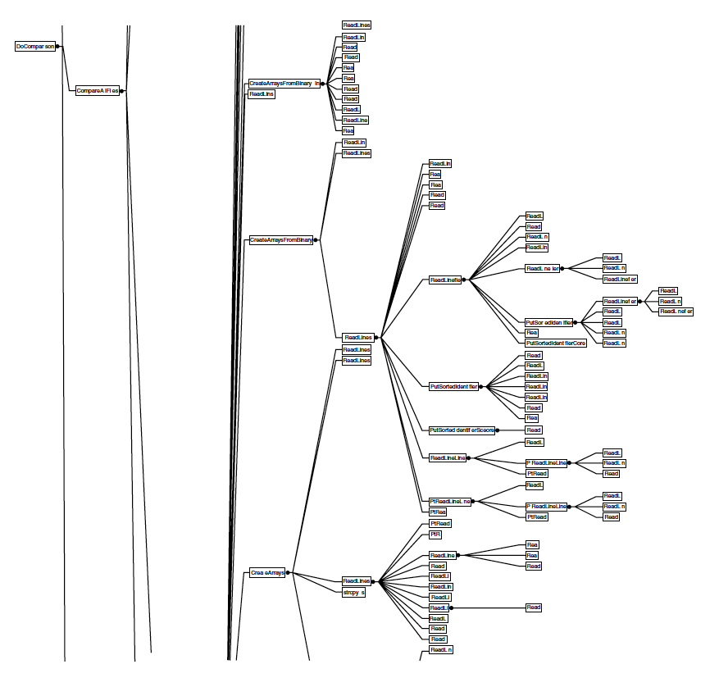
Right Abstraction Level?
20% of CodeSuite

Slide 39
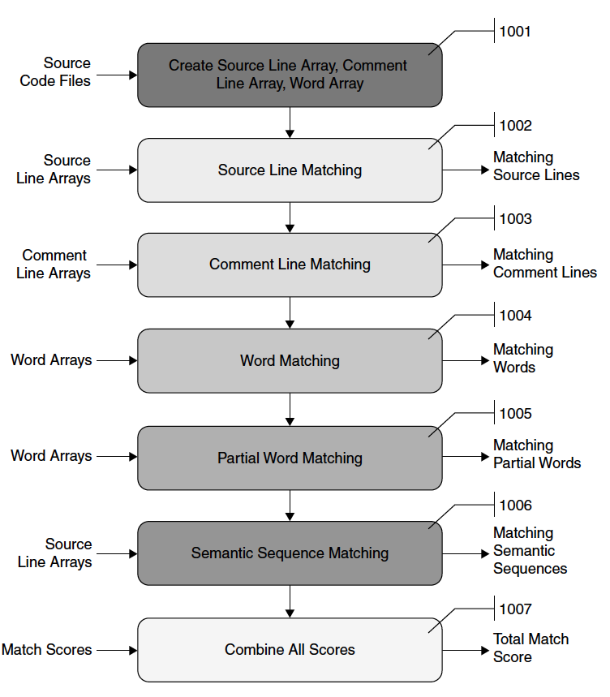
Right Abstraction Level?

Slide 40
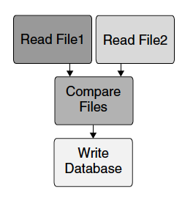
Right Abstraction Level?

Slide 41
Right Abstraction Level?

Slide 42
Copyright Infringement Checklist
Unzip all files to make sure that there are no compressed directories or files that would otherwise escape analysis.
When examining binary files, check for and run any installers so that their output executables can be examined directly.
Search the entire directory tree and note all file types, looking for all source code files.
Perform global searches of directories with a tool that can examine text and binary files
Check for the string “Copyright” in all of the files
Check the files for the names of all companies involved in the litigation
Check the files for the names of programmers at all companies involved in the litigation
Check the files for any technical or business terms that may directly relate to the technology or industry at issue in the case
Check for any third-party files among the code being examined.
Set up CodeSuite and report the indicated cost to the client, for approval, before running the analysis.
Run CodeSuite with a high file threshold of at least 64 files to compensate for future filtering.
Export the CodeSuite database to an HTML report; filter out any obvious source code elements, files, and folders that are not of interest.
9. Examine the file pairs with the highest scores to make an initial determination of whether copying occurred.
10. Run SourceDetective on the CodeSuite database; filter out commonly used elements.
Determine an appropriate hit level to filter.
Filter the high hit count matches out of the database.
Filter out elements with low hit counts that seem unimportant.
Eliminate elements that correlate because of third-party code, codegen, common elements, algorithms, and authors.
Examine the code around every remaining matching element after filtering
Report preliminary findings to client, especially identifiers, statements, and comments with zero Web matches.
Ask the client if there are certain elements (e.g., screen shots, identifier lists, etc.) in which they may be interested.
For each file in a folder of files being compared, examine the detailed report for the file that with highest correlation.
Examine all detailed reports for file pairs with correlation scores over a certain threshold.
Compile a list of file pairs that require further examination. E.g.,
Compile side-by-side screen shots of interesting code snippets.
Create lists of interesting identifiers, statements, and comments.
Create lists of interesting files.
Manually recheck the lines of interest inside the files before submitting a final report to the client.

