Slide 1
CSci699 Software Forensics
Detecting (1) Copyright Infringement (2) Patent Infringement (3) Trade Secret Theft

Slide 2
Detecting Patent Infringement
First understand what the patent means
Interpret the claims
Essence of the patent
Patent’s “bounding box”
Claim construction is critical
Definition of key terms appearing in the claims
Some terms may be given their “plain and ordinary meaning”
Decided during Markman hearings

Slide 3
Markman Hearing
Markman v. Westview Instruments, Inc.
SCOTUS decided that courts (i.e., judges) should interpret the claims
It was done by juries prior to 1996 based on expert-witness testimony
Phillips v. AWH Corp.
Intrinsic evidence
Patent
Prosecution history
Foreign and related patents and their prosecution histories
Prior art cited or incorporated by reference in the patent and prosecution history
Extrinsic evidence
Inventor testimony
Expert testimony
Other documentary evidence
Dictionaries
Treatises

Slide 4
Example CC
Seven Networks, LLC v. Google LLC
https://casetext.com/case/seven-networks-llc-v-google-llc-2
Seven’s patents that manage mobile traffic to conserve N/W and battery
Agreed terms
E.g., “alarms” = “time-based triggers used by applications to schedule tasks”
E.g., “on a periodic basis” = “recurring at approximately regular intervals”
Disputed terms
E.g., “delay a timing of one or more triggers” Seven: plain and ordinary meaning (include delays for unspecified periods) Google: “move the timing of one or more triggers to a later point of time” Court: “move the timing of one or more triggers to a time after the trigger(s) were originally scheduled”
E.g., “adjust a timing of activities . . . to reduce usage of at least one resource” Seven: plain and ordinary meaning (include adjustments to frequency) Google: “move a timing of activities . . . to reduce usage of at least one resource of the mobile device” Court: plain and ordinary meaning

Slide 5
Examining the Software
You have to match the system to the description in the patent
Search for comments
Search for identifier names
Review from a high level
Instrument running system
Best to match this with other information
Documentation
Fact-witness testimony

Slide 6
Problems with Suggested Steps
Comments are unreliable
Missing
Outdated
Wrong
In different languages
Identifiers can be useless
There may be thousands of them
Any similarity could be incidental
It’s not the nouns, it’s the verbs
Instrumentation may be impossible
You have to compile and run it first
Severe constraints on access to code

Slide 7
Problems with High-Level Review
What you see in the code can be deceiving
Prescriptive vs. descriptive architecture
Design constructs
Component
Connector
Event
Broker
Implementation constructs
Method
Variable
Array
Pointer

Slide 8
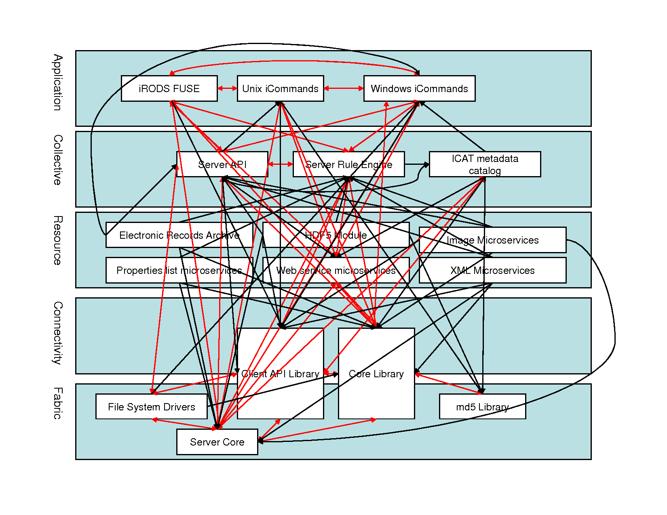
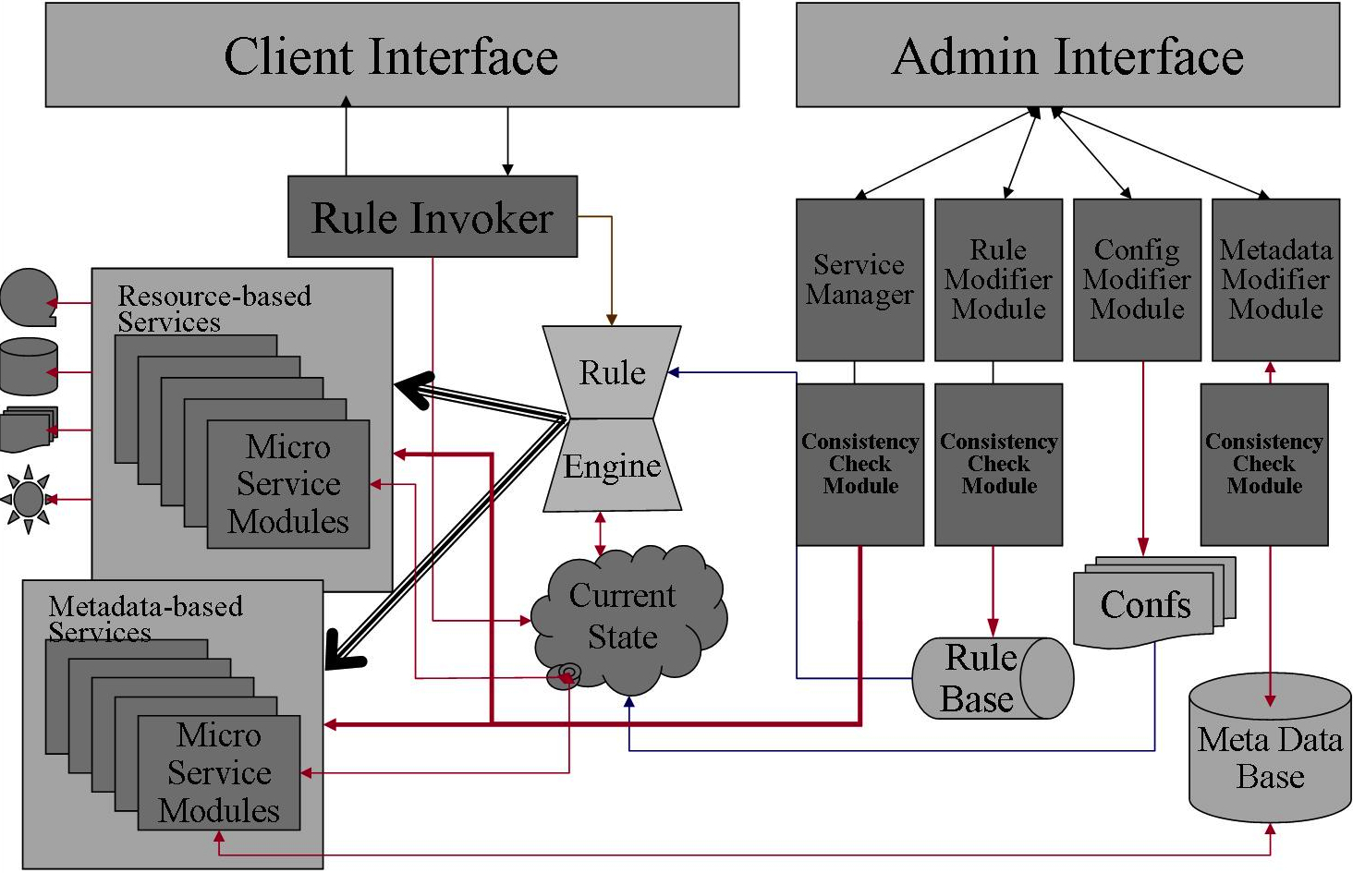
Remember iRODS?

Slide 9
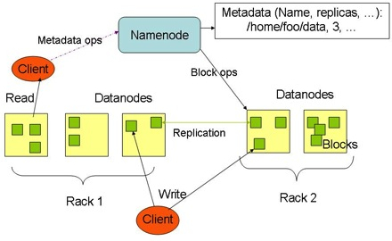
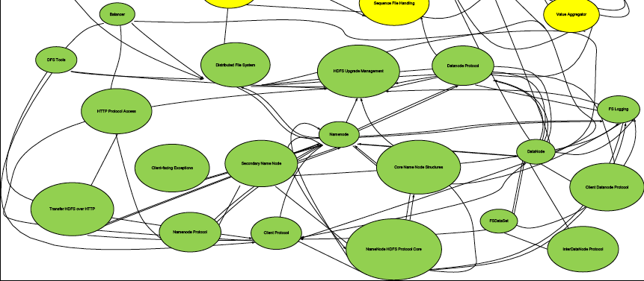
…or Hadoop
Hadoop Distributed File System – Prescriptive Architecture
HDFS – Descriptive Architecture

Slide 10
So What Do You Do?
Assemble a puzzle
Look for circumstantial evidence
Find a combination of evidence
Public documents
Proprietary documents
Fact-witness statements
Source code
System testing
Must do so for every element of every asserted claim
”Smoking guns” are rare
Preponderance of evidence
At least 51% likelihood

Slide 11
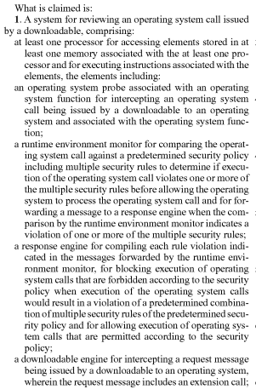
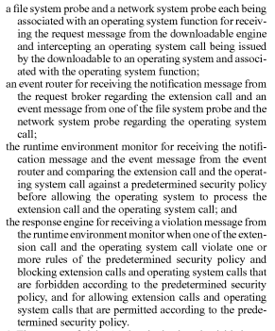
Recall Patent Claims
6
1
7
2
8
3
9
4
10
5

Slide 12
Determining Patent Validity
Wouldn’t the USPTO have caught it?
Based on Sections 102, 103, and/or 112 of MPEP
the Manual of Patent Examining Procedure
Clear and convincing evidence
“highly and substantially more likely to be true than untrue”

Slide 13
Invalidity Based on MPEP 35 U.S.C. § 102
Anticipation
Every limitation of a claim is found in a prior art reference
POSITA is enabled by prior art to make and use the claimed invention
Public use or on sale
Claimed invention was available more than one year prior to patent filing
The device/system must have anticipated or made obvious the invention

Slide 14
Invalidity Based on MPEP 35 U.S.C. § 103
Obviousness
POSITA would have known this
Requires combination of references
Prior art teaches, suggests, or motivates the combination
“TSM”
Hindsight is not allowed

Slide 15
Invalidity Based on MPEP 35 U.S.C. § 112
Inadequate written description
Inability to (re)construct the invention
Lack of enablement
POSITA must be able to make and use the invention without undue experimentation
Failure to disclose the best mode of implementing
Preferred embodiment
Indefiniteness
must disclose an algorithm for performing the claimed function

Slide 16
Undue Experimentation
Based on the following criteria
the breadth of the claims
the nature of the invention
the state of the prior art
the level of one of ordinary skill
the level of predictability in the art
the amount of direction provided by the inventor
the existence of working examples
the quantity of experimentation needed to make or use the invention based on the content of the disclosure

Slide 17
Detecting Trade-Secret Theft
A trade secret
is not generally known to the public
confers some sort of economic benefit on its holder
the benefit results from not being known to the public.
is subject to reasonable efforts by the owner to maintain its secrecy
Typically not defined in a precise, detailed document
Often depends on code
What if you stumbled on the same invention/solution?

Slide 18
Proving Trade-Secret Theft
Top-down
Start at highest-level system description
Find relevant functions, algorithms, structures
Challenged by possible interplay of many pieces
Context of use is important!
Risks false positives
Bottom-up
Compare code for similarity
Completely dissimilar code could do the same thing
Risks false negatives
Copied code is always trade-secret theft*

Slide 19
Trade Secret Theft Example (1)
Facebook, Inc. v. Power Ventures, Inc.
Facebook alleged that Power Ventures collected data from Facebook for its own site
power.com enabled users to aggregate data about themselves
Social networking sites
Messaging services
Scraped data instead of using Facebook Connect
Damages to Facebook – $3M

Slide 20
Trade Secret Theft Example (2)
Attia v. Google, Inc.
Eli Attia invented “Engineered Architecture”
Google X signed an NDA
Signed ISA to build software to implement EA technology
Inbound Services Agreement gives Google a license
Google then filed several patents

