Slide 1
Security Analysis of Embedded Firmware
Software Forensics Class
Dr Nenad Medvidovic
Presenter
Sima Arasteh

Slide 2
Outline
Background
Challenges
Methodologies
Examples
Limitations
Future and Open areas

Slide 3
Background
What is embedded system?
A computer system used in electrical devices
What is firmware ?
A special software runs on embedded device

Slide 4
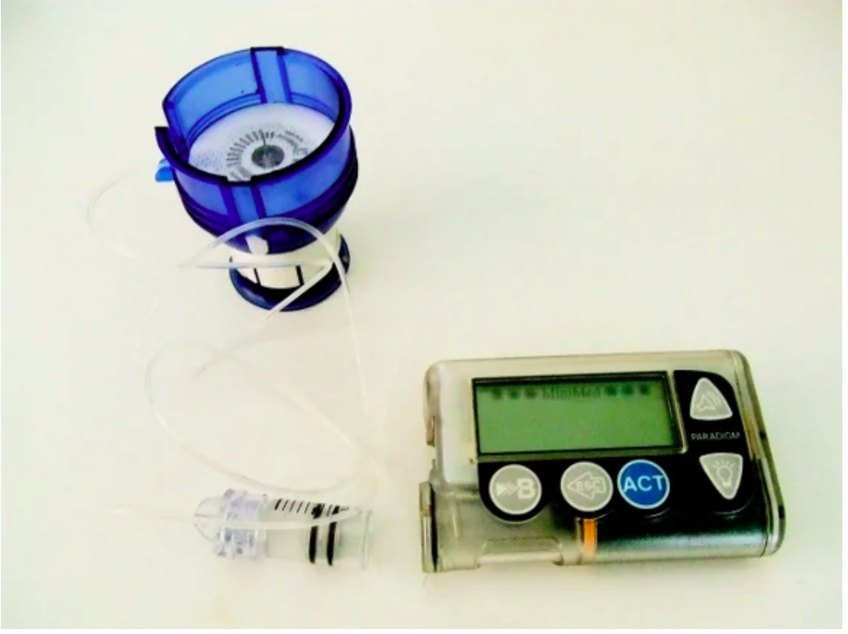
Background
Why Firmware Security is important?

Slide 5
Challenges in Firmware Security
Several Architectures and devices
Source code is not available
S.T Binary code is not available
How to apply one approach to another devic
Intellectual Property
Building a Representative Dataset

Slide 6
Challenges in Firmware Security
How much reliability does the extracted firmware have?
B. Firmware Identification

Slide 7
Challenges in Firmware Security
Unique Firmware Format
Unique Compression Algorithm
C. Unpacking and Custom Formats

Slide 8
Challenges in Firmware Security
. Results from static Analysis should be tested on Device
D. Results Confirmation

Slide 9
Methodologies
Static Approaches
Dynamic Approaches

Slide 10
Methodologies
Dynamic Analysis
Disadvantages:
Accessing to physical Device is very hard and expensive
Need authorization for some operations
Advantages:
Can handle situations happen in real time

Slide 11
Methodologies
Static Approaches
Advantages :
It does not need to access to the device
It is fast and has code coverage
DisAdvantages :
Cannot be resistance for obfuscation
For some cases the results are not reliable

Slide 12
Examples (Static Approach)
Firmalice
Automatic Detection of Authentication
Bypass Vulnerabilities in Binary Firmware

Slide 13
Examples (Static Approach)
How to load a Firmware
Define Security Policies
Firmware Loading
Security Policies
Static Program Analysis
Symbolic Execution Engine
Authentication Bypass Check
Generate Program Dependency and uses this graph to create an authentication
slice from an entry point to the privileged program point
This module can check whether the found input bypass the authentication

Slide 14
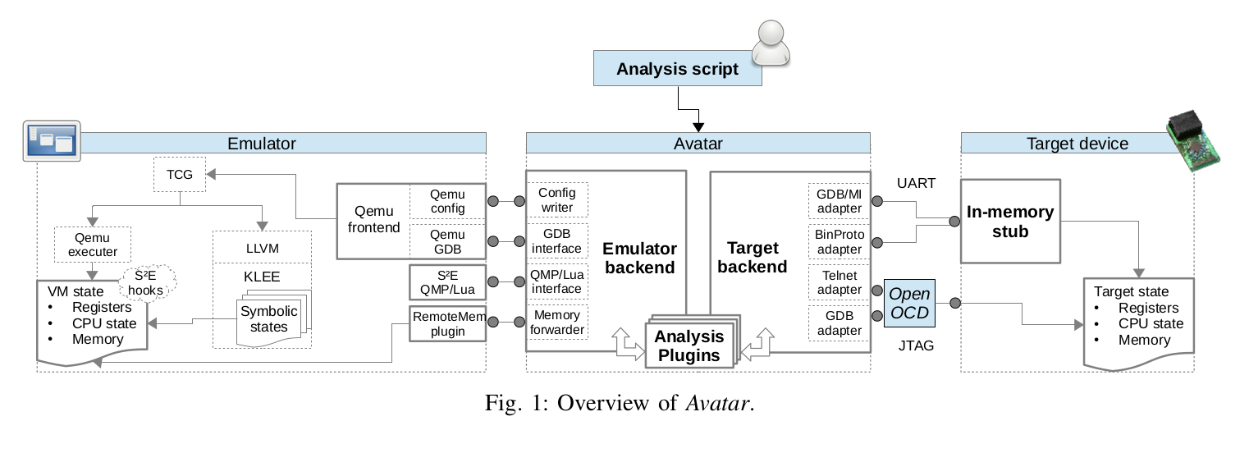
Examples(Dynamic Approach)
Full-Separation Mode
Context Switching
Interrupts Handling

Slide 15
Limitations
There is no general method to cover all embedded devices
There is no flexibility to apply one method to all devices

Slide 16
Future Works and open Areas
A linguistic study of Packing algorithms
Gathering a general Dataset
Creating more Independent Emulators

Slide 17
Question ?

