Slide 1
Software Forensics in Practice

Slide 2
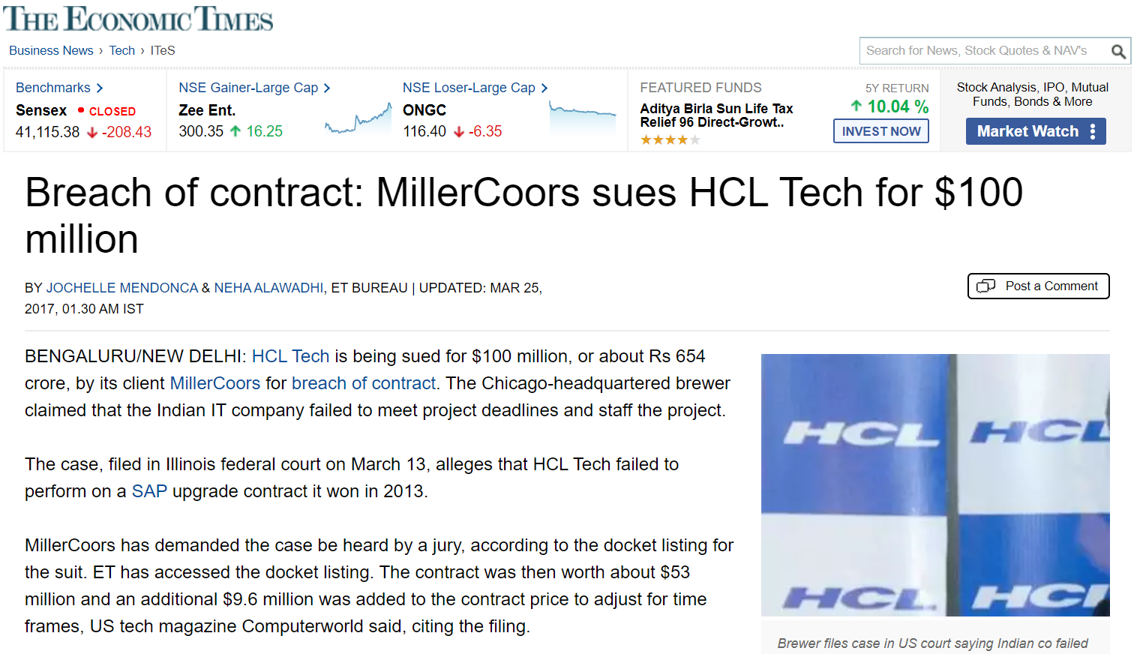
https://economictimes.indiatimes.com/tech/ites/breach-of-contract-millercoors-sues-hcl-tech-for-100-million/printarticle/57819765.cms

Slide 3
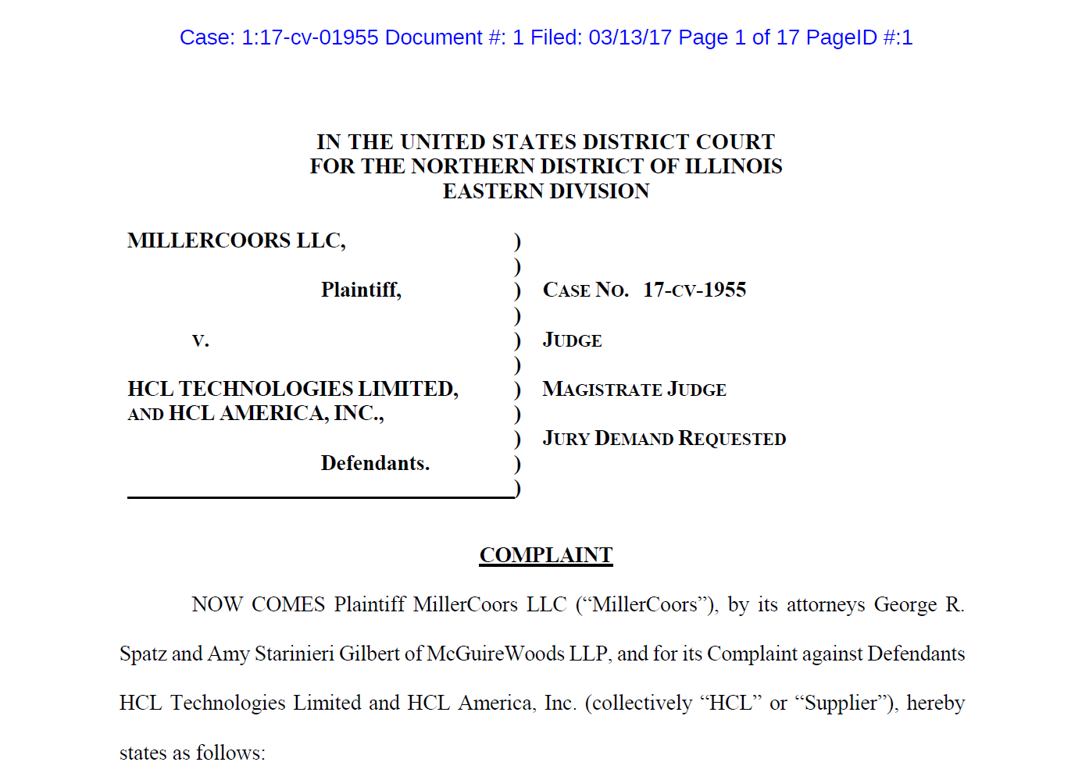

Slide 4
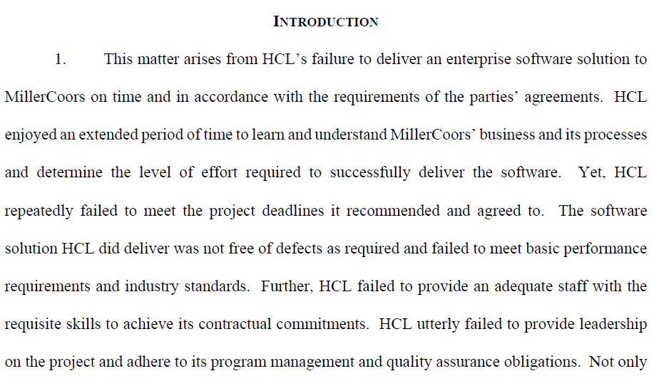
Settled

Slide 5
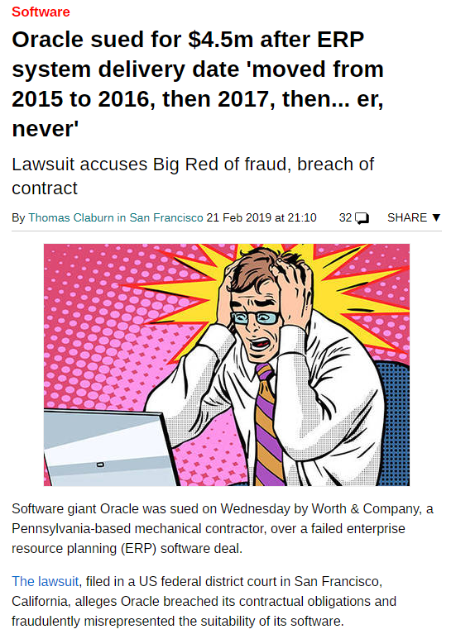
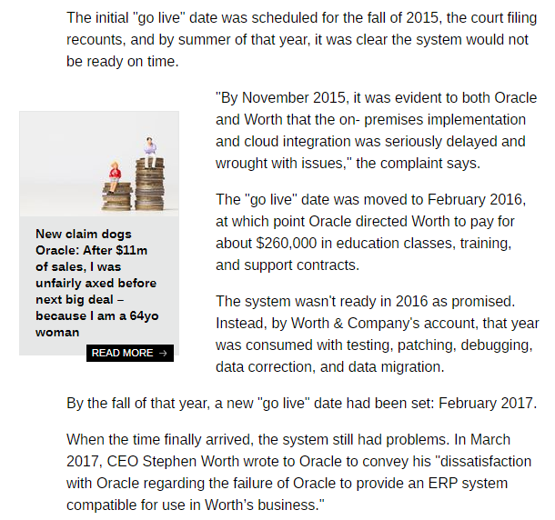
https://www.theregister.co.uk/2019/02/21/biz_sues_oracle/

Slide 6
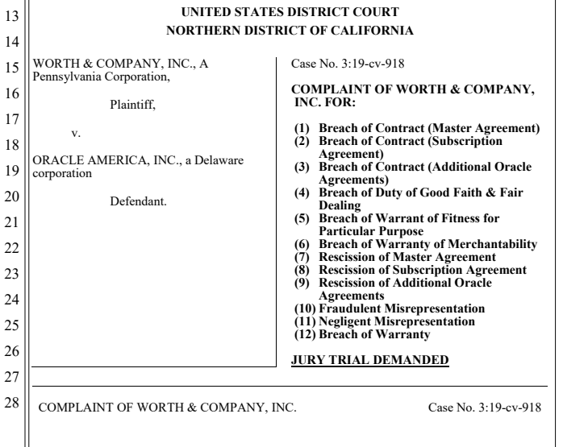

Slide 7
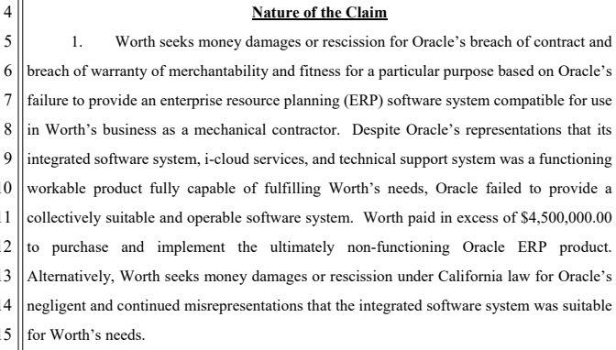
On-going

Slide 8
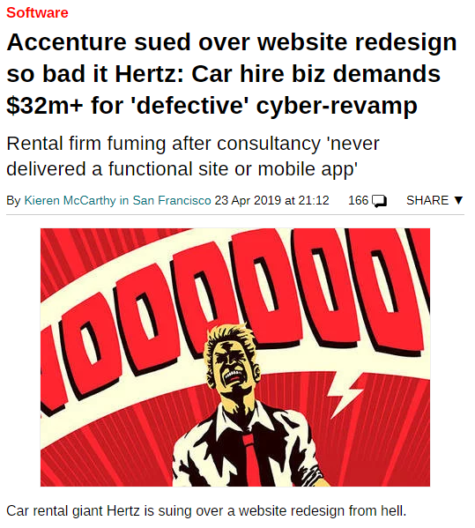
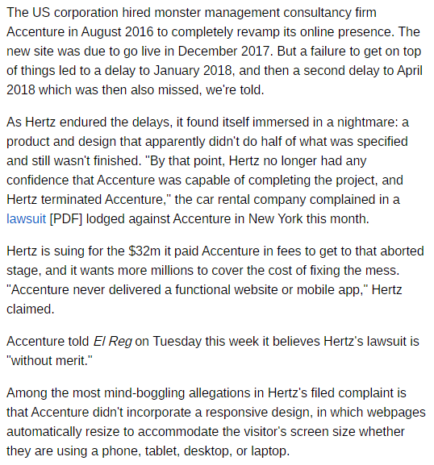
https://www.theregister.co.uk/2019/04/23/hertz_accenture_lawsuit/

Slide 9
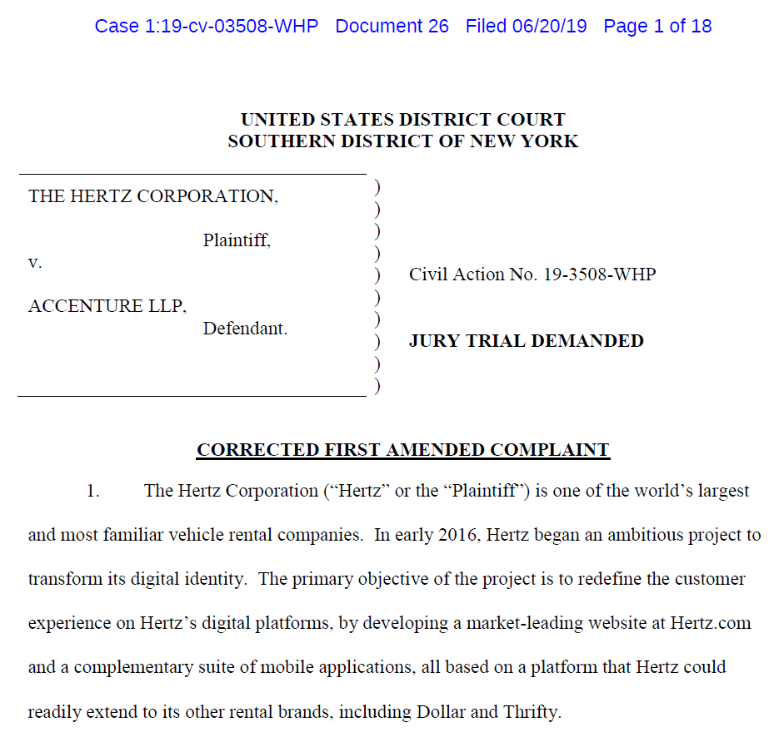

Slide 10
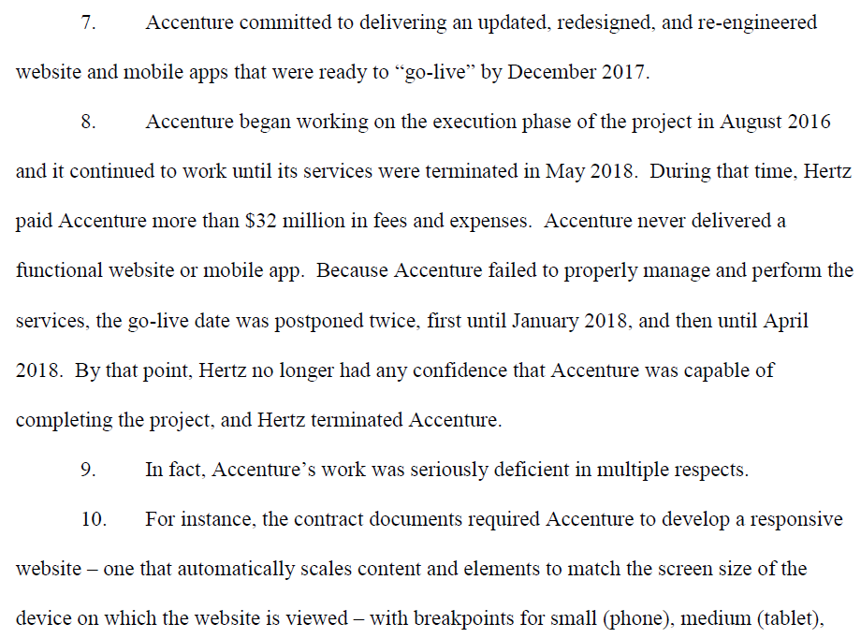
On-going

Slide 11
Questions
Claims in the complaints
“... not free of defects as required and failed to meet basic performance requirements and industry standards.”
“... failed to provide collectively suitable and operable software system.”
“... never delivered a functional website or mobile app.”
“... work was seriously deficient ...”
Are they true?
Are they supported by scientific evidence?
Is there another side of the story?
Who can identify the evidence from what?

Slide 12
Software Forensics in Practice
Real-world breach-of-contract lawsuits,
software expert witnesses, and
life as a software consulting expert

Slide 13
Outline
Breach-of-contract lawsuits
What is an expert witness?
Roles of a software expert witness
Source code discovery deep dive
Life as a software expert

Slide 14
Breach-of-Contract Lawsuits
Software development failures—not an IP infringement!
Often involving “the science of analyzing code”
Numerous different types of situations
A customer paid a developer to build a custom system, and claims the developer did not produce what was promised or overcharged
Two or more companies partnered to create a software system, and each says it’s the other’s fault that it doesn’t work
An expert may opine on why the project failed and whether project cost and timeline were reasonable
Generally involves analysis of bids, requirement specs, internal development standards and guidelines, repo logs, test data, bug reports, and source code
Cost estimation models, code count tools, quality metrics, and complexity metrics are often useful

Slide 15
What is an Expert Witness?
Specialist who testifies in a legal proceeding without having been a witness to an occurrence
Qualified by special experience, training, or knowledge
Testifies about matters not well-understood by lay people
Gives objective, unbiased, and independent opinions
Explains complex technical concepts clearly
Is credible, persuasive, and likable
May be retained by one party, multiple parties, or the court

Slide 16
Testifying and Non-Testifying Experts
Some cases involve multiple experts
One or more testifying experts
One or more non-testifying consultants
The testifying expert(s) author the report and testify
The non-testifying consultants assist in gathering and organizing evidence
Source code review and data analysis are extremely time consuming
Once evidence has been documented, the testifying expert can review everything

Slide 17
Roles of a Software Expert Witness
Providing an expert opinion
Expert report
Deposition
Testimony
Helping with other court filings
Affidavits
Stipulations
Assist, produce, or conduct
Protective order
Evidence discovery
Code review
Expert report
Deposition
Testimony

Slide 18
Protective Order
During the course of serving as an expert, you will receive confidential materials
Must be handled strictly in accordance with a protective order (PO)
Protective order
Parties agree upon the ways in which the case-related materials such as source code will be produced and handled
Subject to the Court’s approval

Slide 19
Protective Order: Source Code
There may be separate undertakings regarding the production and inspection of source code
Important factors
Location of the source code
Review environment
Review hardware and software
Access control
Network, peripherals, copying data in and out, etc.
Printing
How many pages? Font size? Even color of the papers.
Break room
Monitoring reviewers

Slide 20
Stipulated Protective Order
Specifies restrictions on access to confidential materials
Different classes of materials may be enumerated
For example:
“Confidential”
“Confidential – Outside Counsels’ Eyes Only”
“Confidential – Outside Counsels’ Eyes Only – Source Code”
You will execute an Agreement to be Bound by Protective Order
Waiting period during which opposing party can object to your designation
Typically five days

Slide 21
Evidence Discovery
One party requests the other party to produce evidence that is relevant to the case, e.g., source code.
The producing party discloses the requested materials in good faith.
In case of failure to cooperate in discovery, the requesting party may file a motion to compel disclosure.
The producing party is often not cooperative.
Source code discovery strategies
Request for specific items (e.g., code for a certain feature)
Request more than just program code (e.g., DevOps, testing, repo, etc.)

Slide 22
Artifacts to Discover
Documentation
Requirements
Software models
Interface or API definitions
Source code
Version control systems
DevOps—deployment
Communication
Emails, notes, memos, etc.
Testing
Unit testing
System testing
Systems integration testing
User acceptance testing
Jira
Wiki
Anything else that is related to the case

Slide 23
Code Production Challenges
Did you get all the code necessary?
Did you get all the pieces of evidence to prove your arguments?
Challenges
Unable to compile
Unable to deploy
Unable to test

Slide 24
Version Control Systems (VCSs) and Git
What is a (VCS)?
A tool that manages the evolution of source code
Tracking each change
Git
De facto VCS
GitHub is a big factor in the popularity of Git
By analyzing a Git repo, you can learn a lot about what happened during software development
https://static1.smartbear.co/smartbearbrand/media/pdf/the-2019-state-of-code-review.pdf

Slide 25
Git Commits

Slide 26
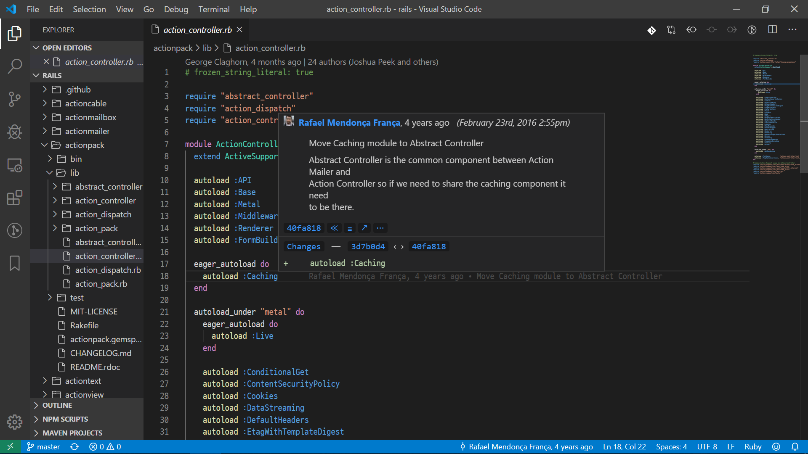

Slide 27
Git Clone
What is a Git clone?
A Git clone is a copy of the target repository.
How to make a Git clone
Always request for a full Git clone
>> git clone <repo>
How not to make a Git clone
Using any parameters that exclude information from the repo
For example,
>> git clone -depth=1 <repo>
This will create a clone with only the most recent commit

Slide 28
GitHub
Two versions of GitHub
GitHub.com
GitHub Enterprise
Organizations and repositories
Remote of a Git repository
Host: https://github.com
GitHub organization: rails
GitHub repository: rails.git

Slide 29
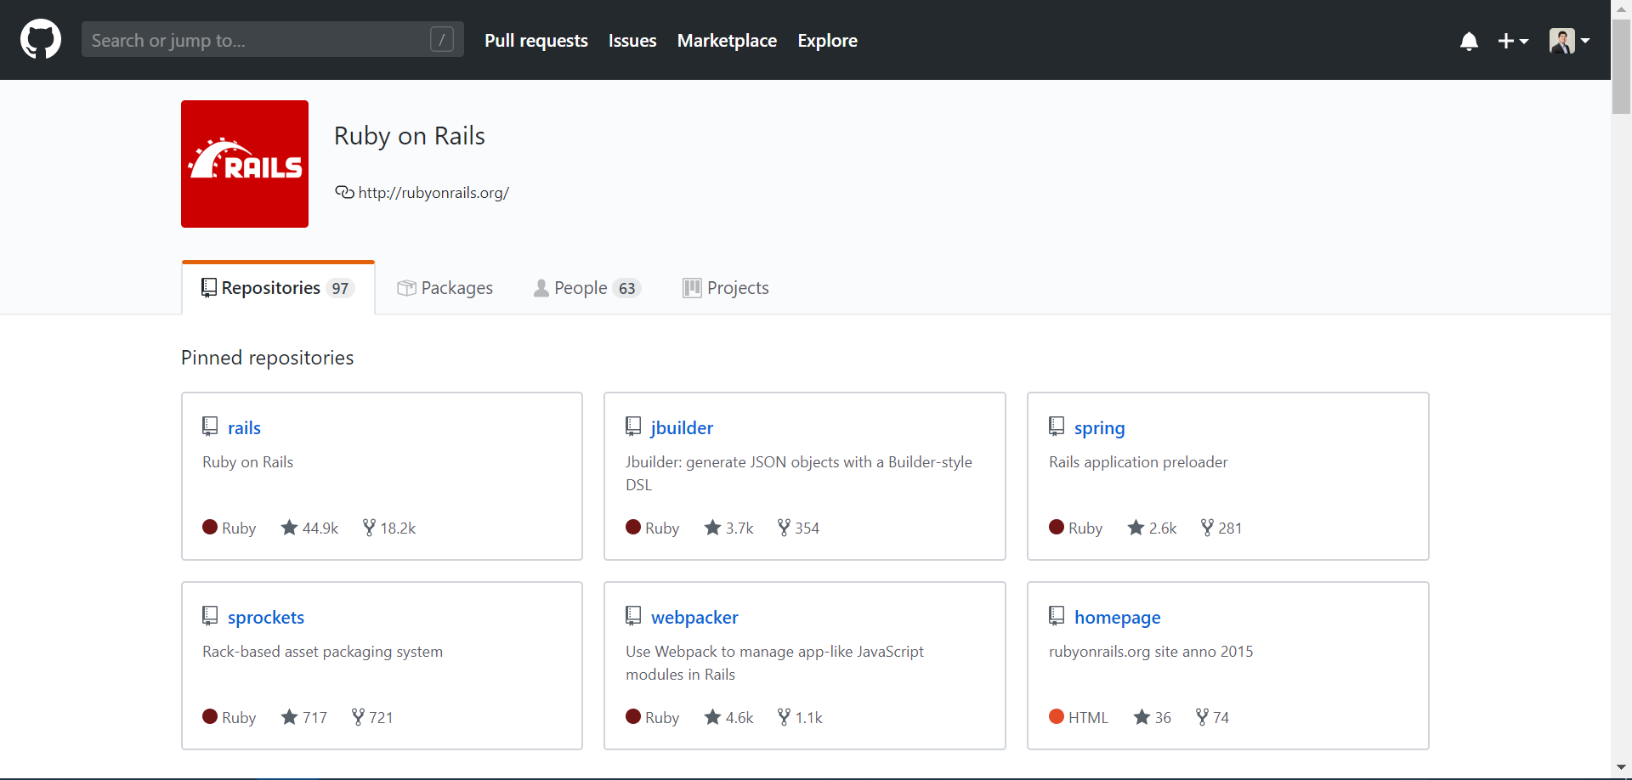
GitHub Organization

Slide 30
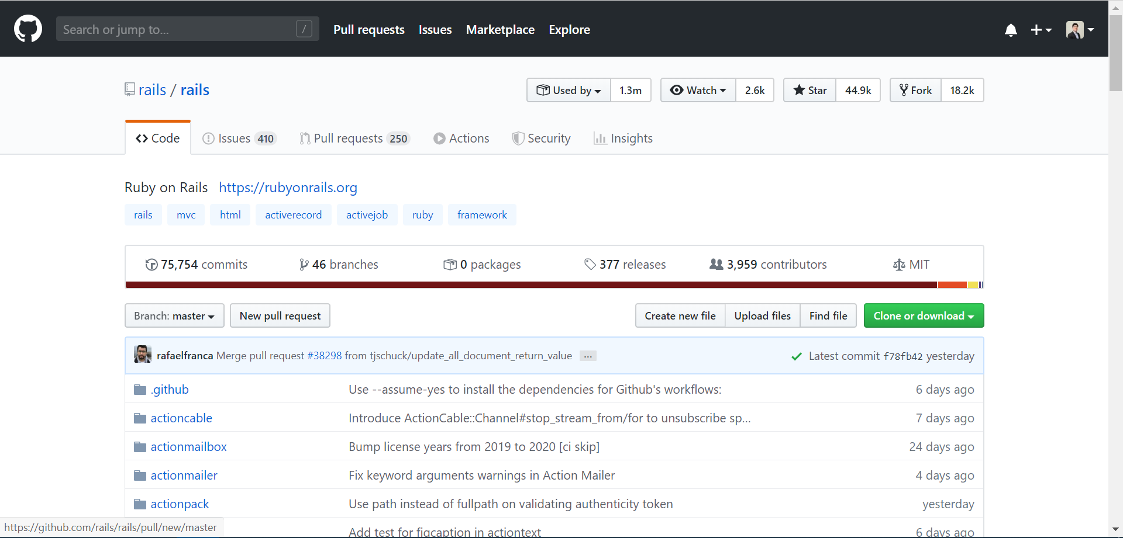
GitHub Repository

Slide 31
Do You Have Everything?
Documentation
API documents
README.md
Dependencies
Makefile
package.json

Slide 32
Source Code Review
Where is the code?
Who may view the code?
What restrictions are there in viewing the code?
Depending on the PO
May only be viewed on specific computers
May only be viewed in specific locations where electronic devices are prohibited
May only be viewed during certain hours of the day
May only be stored in encrypted form in locked cabinet
May not be transmitted electronically
May only be printed in limited quantities

Slide 33
Expert Report
Foundation of the expert’s opinion
Serves as the basis for deposition and cross examination
Should be honest, clear, and concise
When the other party has the burden of proof, you write a rebuttal
Affirmative and rebuttal reports

Slide 34
Expert Report Components
Credentials and experience
Emphasize items from your CV that are relevant to the case
List of previous testimony
Scope of engagement
What you were asked to do and what you are being paid
Information relied on for your opinion
Maintain a list over the course of the engagement
Only list items actually needed
Summary of understanding of relevant legal concepts
Avoid boilerplate language
Opinion
Structure and format vary widely

Slide 35
Deposition
Opposing counsel’s opportunity to learn what your testimony is
Discover what you know
Look for favorable evidence
Commit you to statements under oath
Discredit your testimony/create the basis of a Daubert motion
Learn your retaining counsel’s arguments or defenses
Preserve testimony for trial
Your primary duty is to tell the truth

Slide 36
Testimony
Testifying in the court of law
May use demonstrative evidence
Cross examination
Fight back when your conclusions or methods are challenged
Convey the need for the expert opinion
Jurors may think they know enough

Slide 37
Life as a Software Expert
What do I do every day?
Meetings (travels often required)
Analyzing source code (often at a remote location)
Assessing documents, materials, etc.
Researching new software analysis techniques and tools
Discoverability
Communication and notes
Security
Encryption of data
Storing data in safe locations

Slide 38
Types of Cases We Do
Software-related IP litigation
Patent infringement
Breach of contract
Copyright
Trade secret
Due diligence
Software-related acquisitions
Software audit
An objective third party is required

Slide 39
Wrapping Up
Summary
Breach-of-contract lawsuits
What is an expert witness?
Roles of a software expert witness
Source code discovery deep dive
Life as a software expert
Any questions?

