Slide 1
CSci699 Software Forensics
Course Introduction
January 13, 2020

Slide 2
What Is Software Forensics
The science of analyzing code (source or binary) to determine whether IP infringement or theft occurred
Centerpiece of lawsuits, trials, and settlements
Disputes involving software patents, copyrights, and trade secrets
Software forensics tools are automated aids for comparing code to determine differences and correlations between software systems…
…and much more!

Slide 3
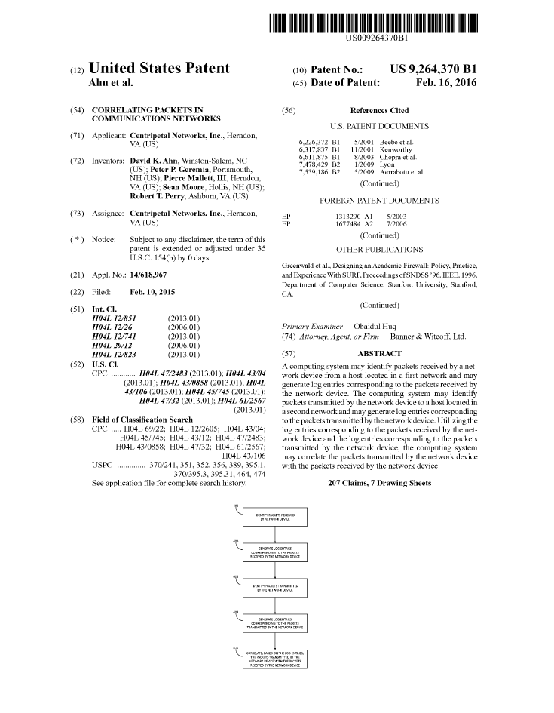
Software Forensics ☞ Software Engineering
Software forensics goes beyond code comparison
Forensics experts are very experienced software engineers
Huge amount of available information
Source code
Binaries
Technical documentation
Patents
Design artifacts
Standards
Similar systems
Websites
Datasheets
Marketing materials
Sworn testimony from system developers
…

Slide 4
Software Forensics ☞ Software Engineering
Software forensics goes beyond code comparison
Forensics experts are very experienced software engineers
Huge amount of available information
Source code
Binaries
Technical documentation
Patents
Design artifacts
Standards
Similar systems
Websites
Datasheets
Marketing materials
Sworn testimony from system developers
…

Slide 5
Relevant Software Engineering Activities & Artifacts
Requirements
Specification
Architecture
Design
Analysis
Implementation
Reuse
Testing
Deployment
Maintenance
Evolution
Adaptation
Frameworks
Middleware
Cloud
Microservices
Generation
…but also obsolete technologies

Slide 6
Beyond Engineering
Lawyers
Mediators
Patent examiners
Judges
Juries
The press
… and everyday people with jobs

Slide 7
When Things Get Fun
“Sausage-making”
Protective orders may severely restrict analysis
Lawyers, judges, and juries may be computer/software illiterate
The best story may win…
…even it it isn’t the true(st) story

Slide 8
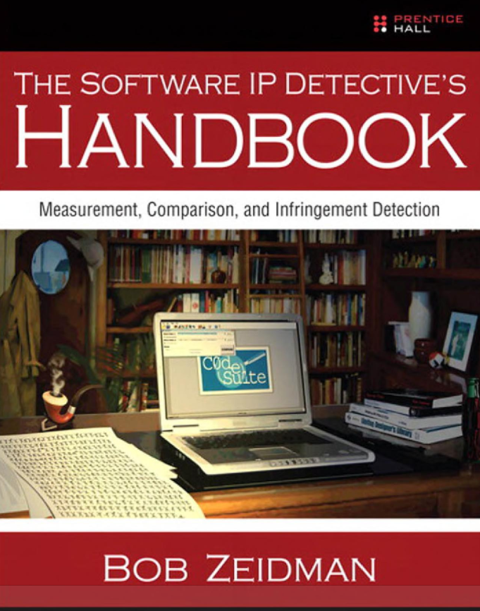
This Class
Covers forensics from a software engineering perspective
Refers to actual cases
Distinguishes ideal from real-world
Book + reading supplements + tools

Slide 9
What You Have to Do
Read 0% 🤓
Participate 10%
Present once 20%
Take one exam 30%
Do a project 40%

Slide 10
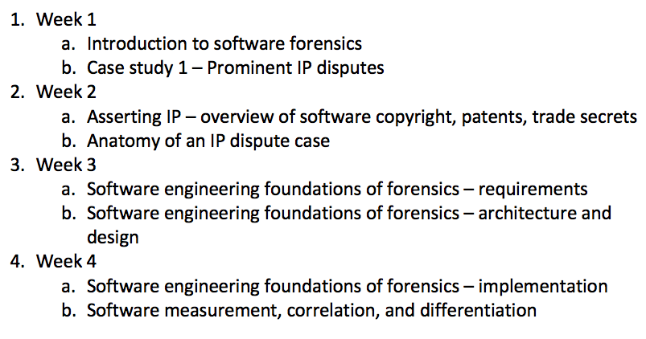
Schedule (Weeks 1-4)

Slide 11
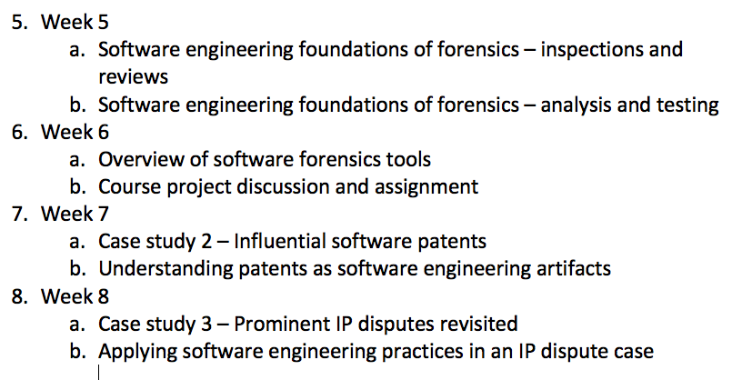
Schedule (Weeks 5-8)

Slide 12
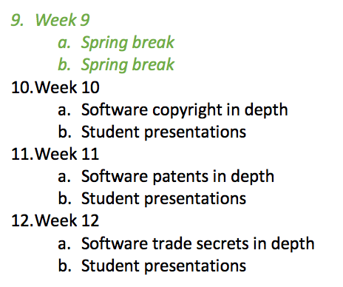
Schedule (Weeks 9-12)

Slide 13
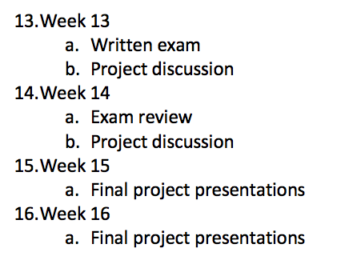
Schedule (Weeks 13-16)

Slide 14
For Wednesday, 1/15
Obtain the book
Read Chapter 2 (it’s only a couple of pages!)
Find a software dispute you want to discuss
Read about it
Be prepared to say a few words
Who were the parties?
What were the issues?
How did software figure in the case?
What happened?
Did you agree with the outcome?

