Slide 1
Software Piracy
Nikola Lukic
CS699 – Software Forensics

Slide 2
What is Software Piracy?
Legal Protection
An End-User License Agreement (EULA).
Product Key
Aunique combination of letters and numbers used to differentiate copies of the softwar.
Temperproofing
Build-in source-code temper detection protocols.
Shut down software.
Watermarking
Visible/Invisible Watermarks.
Fragile Watermarks.
Software piracy is the illegal copying, distribution, or use of software.^{[1]}
Notes:
- What makes interaction with software legal/illegal.
- EULA is an "agreement" beween the software distributor and end user. Just a list of thing you are not supposed to do.
- First EULAs were supposed to stop unauthorized copying of the software (1980), but then they expanded.
2) This pretty self-explainatory section is the most important section to be read. If you do not agree to the licensing restrictions then you may not use the software.
3) You are just an user of the software, not the owner! The end user purchases a limited, non-exclusive and non-transferable license to use the software. At no point does the end user purchase the ‘software’.
4) The warranty section essentially highlights the fact that there isn’t really a warranty! The software and license is provided by the vendor ‘as is’.
5) Reminds you that the vendor takes no responsibility or liability for any damages that the end-user may encounter when using the software. E.g. if you play a video game that is not supported by your graphics card (somehow) and it gets overheated and breaks – it's your fault! You are paying for it!

Slide 3
End-User License Agreement
EULA is a legal contract entered into between a software developer or vendor and the user of the software.^{[2]} Some sections of the EULA^{[3]} :
Grant of License
Restrictions of Use
Ownership
Warranty
Limitations of Liability
"That time-consuming, unnecessary thing you just click next, next, agree, next, next,…" when you install software

Slide 4
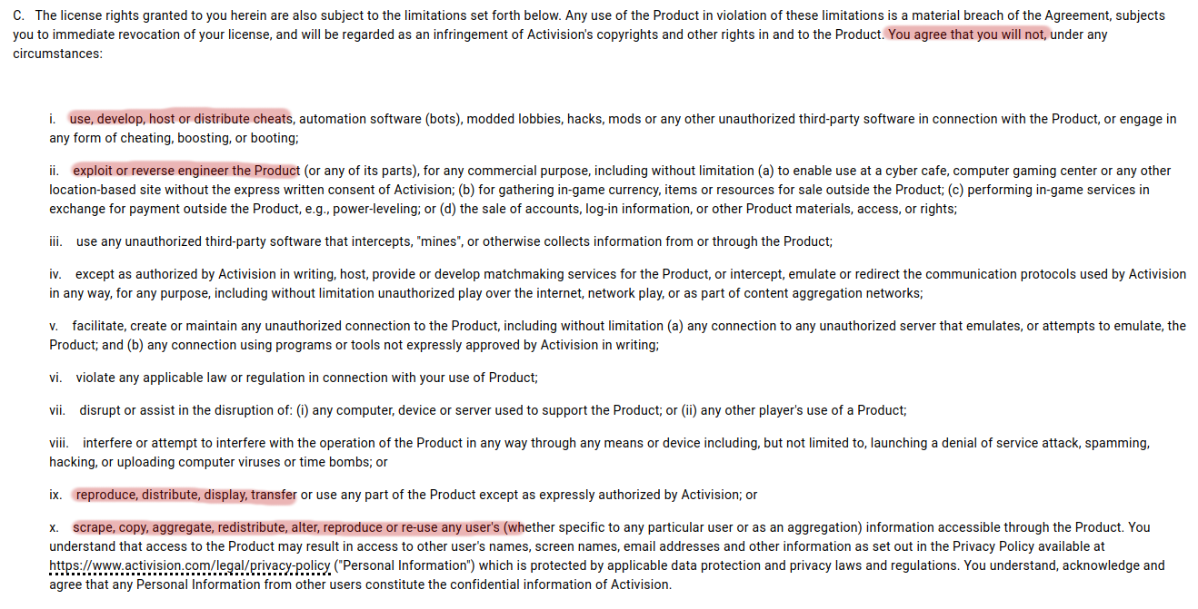
Grant of License
In here, vendors highlight terms of use.
Is it permited for commercial use or only personal use is granted?
This part states that by agreeing to EULA, you will be forbiden to sell, share, distribute or sublicense the software.
Notes:
Grant of License - Vendors highlight the terms of use, and whether it’s permitted for use within a commercial environment or whether it’s for personal use only. Here it talks about ‘non exclusive’ and ‘non-transferable’ aspect. This means that by accepting the EULA you agree not to sell, share, distribute or sublicense the software.

Slide 5
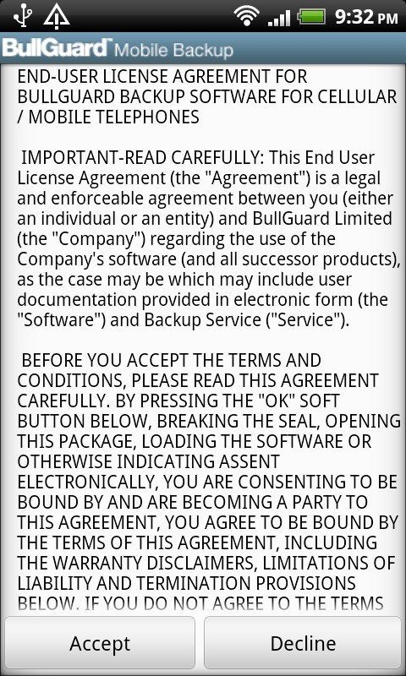
EULA - License Restrictions
This part is the most important part to be understood by the end-user.
This section highlights the parts from the grant of license.
If the user not agree to the licensing restrictions, then they may not use the software.

Slide 6
EULA - Ownership
End-user is just a user of the software, not the owner!
Most commonly, end-user purchases a limited, non-exclusive and non-transferable license to use the software.
In this part, it usually mentions the ownership of the content produced by the end-user while using the software under license.
Notes:
ou are just an user of the software, not the owner! The end user purchases a limited, non-exclusive and non-transferable license to use the software. At no point does the end user purchase the ‘software’.
Google Chrome EULA Claims Ownership of Everything You Create on Chrome, From Blog Posts to Emails
Warcraft 3 Reforged EULA gives Blizzard total ownership of all custom games

Slide 7
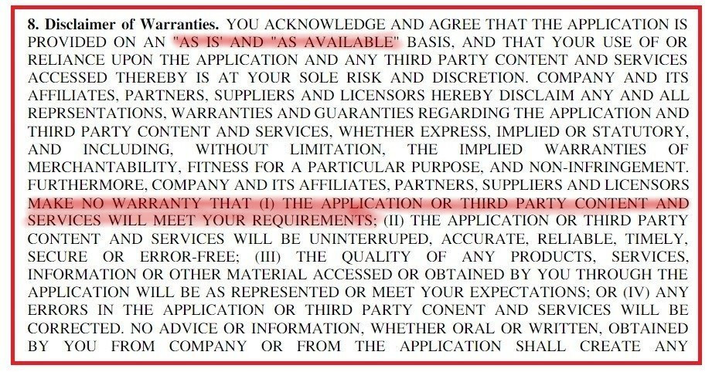
EULA - Warenty
The software and license are provided by vendor to end-user "as is" or "as available".
Notes:
For example, if you have a business intelligence software app that tracks sales for a company and your servers are down for a period of time and sales cannot be tracked, a disclaimer of warranties will prohibit a company from holding you responsible for lost data or lost sales.
NO DATA LOST IS VENDOR FAULT

Slide 8
EULA - Limitations of Liability
Here, vendor makes it clear that they will not be held responsible for any damages that arise out of the use of the app.^{[5]}
This part is changing and evolving, due to ways software can affect everyday life (e.g. Autonomous Vehicles) .

Slide 9
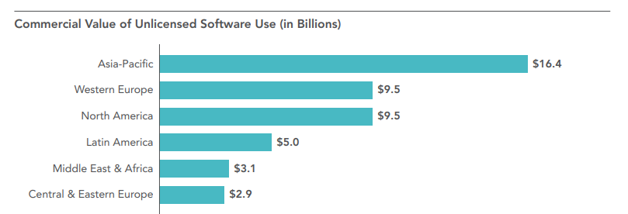
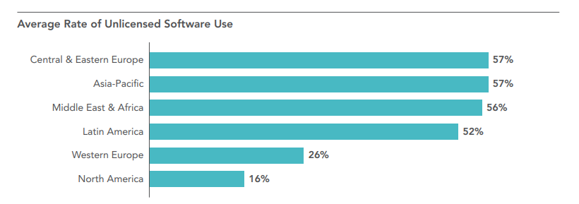
How Much Pirated Content There Is?
According to the Business Software Alliance report from 2018, 37% of all software used in the world is unlicensed.^{[7]}
Commercial value of unlicensed software in 2018 topped $46B.^{[7]}

Slide 10
Types of Software Piracy
Counterfeiting
Internet Piracy
Free download from websites
Peer-to-peer networks
End User Piracy
Reusing of one licensed copy
Copying of discs
Acquiring non-retail software without legal permission
Client-Server Overuse
Hard-Disk Loading
Notes:
Counterfeiting – we talked about this a lot in this class. duplication, distribution and/or sale of copyrighted material with the intent of imitating the copyrighted product.[6]
Internet Piracy – download of illegal, non-licensed software from the internet
Client-Server Overuse This type of piracy occurs when too many users on a network are using a central copy of a program at the same time. If you have a local-area network and install programs on the server for several people to use, you have to be sure your license entitles you to do so. If you have more users than allowed by the license, that's "overuse."
Hard-Disk Loading This occurs when a business sells new computers with illegal copies of software loaded onto the hard disks to make the purchase of the machines more attractive.

Slide 11
BitTorrent
Probably most popular way of distribution of pirated content, including software.
Use of BitTorrent have introduced many novel legal issues (tracking end-user through IP addresses acquired through their Internet Service Providers).
First legal sentence for using BitTorrent protocol for unlicensed/illegal files, was given out in Finland in December 2004 (Finreactor)
US leads the way in civil and legal cases for fighting this type of software piracy.
However, this is still doable using VPN!

Slide 12
Software Cracking
Software Cracking is the process of disabling undesireble featured of a software product (copy protection most commonly).
A modern-day software crack refers to the means of achieving a stolen serial number or a tool that performs that act of cracking.
Keygen
Patch
Loader
Philip Don Estridge said: "I guarantee that whatever scheme you come up with will take less time to break than to think of it." - This even stands for today's software products!
The Scene (Warez Scene) is underworld community specialized in (illegally) acquiring and illegally distributing content on the internet (including software).^{[8]}
Notes:
Old day crackers ->
Piece of software that is used for generating License Key for software to be cracked.
Patch -> set of changes to a computer program as it is commonly refered in SE. However, there are mallicious software patches that serve the purpose of cracking. Sometimes its only copy-pasting some particular file(s) and sometimes a dedicated software is run after installation of the wanted software in order to modify it.
Loader -> run on app start point. Cu
A well-known example of a loader is a trainer used to cheat in games.[
Don Estridge - led development of the original IBM Personal Computer (PC)
He said that for the creation of 1980s Locksmith coppier that was able to copy copy-protected floppy disks at the time (embedded into Apple2).
The Scene (Warez Scene) - they are pretty organized. They are not publishing anything that’s low quality

Slide 13
Why unlicensed software is bad?
The study has shown that there is more than 30% chance of encountering malware once a computer is running unlicensed software.
Each malware attack can cost a company $2.4 million on average and can take up to 50 days to resolve. ^{[7]}
Unlicensed software is subject to significant fines for copyright infringement.
In the United States, the maximum criminal penalty for copyright infringement is a fine of up to $250,000 and a jail sentence of up to five years.
It increases the price of license of the software.

Slide 14
References
Piracy, Whatis.com. Margaret Rouse, published September 2005.
EULA Definition, Linux Foundation, published 28 February 2006.
EULA's Explained in Simple Terms, David Foxen, published 4 June 2014.
5 Reasons Your Software Needs EULA, Sara Pegarella, published 25 June 2019
The Challenge of Software Liability, Jane Chong, published 6 April 2020.
Types of Piracy, NortonLifeLock Inc.
BSA Global Software Survey, The Software Alliance, published June 2018
Software Pirate's Code of Honour: A Dive Into The Warez Scene, Anirudh VK, published April 2019

Slide 15
Thank you for listening!
Questions?

