Slide 1
Software Engineering Foundations of Forensics Requirements Engineering

Slide 2
What is Requirements Engineering?
“Requirements engineering is the branch of software engineering concerned with the real-world goals for, functions of, and constraints on software systems. It is also concerned with the relationship of these factors to precise specifications of software behavior, and to their evolution over time and across software families.” (Zave, 1997)

Slide 3
What is a Requirement?
A condition or capability
... needed by a user to solve a problem or achieve an objective
... that must be met or possessed by a system or system component to satisfy a contract, standard, specification, or other formally imposed document
A documented form of 1 or 2
A documented requirement is also called requirements artifact

Slide 4
What is a Requirement?
Can range from a high-level, abstract statements and back of the napkin sketches to a formal specification
May be textual, graphical, symbolic, or some combination
Different application domains have very different assumptions and constraints
Stakeholders have varying abilities to make and read these representations (e.g., a business customer versus a design engineer)

Slide 5
Why is RE Relevant to This Class?
Software patents: a form of requirements document?
Requirements documents are copyrightable material
Software requirements may be trade secrets
Breach-of-contract lawsuits
RE errors are the most expensive

Slide 6
Discussion topic (after the lecture): How Are Requirements Used in Forensics?

Slide 7
Types of Requirements
Levels of abstraction
User requirements
System requirements
Software design specifications
Functional vs. non-functional

Slide 8
Types of Software Projects
Greenfield vs. brownfield
Customer-driven vs. market-driven
In-house vs. outsourced
Single-product vs. product-line

Slide 9
User Requirements
Abstract statements written in natural language and/or informal diagrams
“Sensitive data stored in the system is only visible to authorized users.”
Specify what services (user functionality) the system is expected to provide and any constraints, in terms of high-level goals
Examples:
Concept of operations (conops)
System metaphor
User stories

Slide 10
System Requirements
Detailed descriptions of the services and constraints
“Users shall be authenticated using a username and password.”
Derived from analysis of the user requirements
More structured and precise than user requirements
May be written in structured natural language and/or semi-formal diagrams
May act as contract between client and contractor

Slide 11
Software Specifications
The analysis and design documentation used as basis for implementation by developers
“Passwords shall be at least 8 characters and contain letters, numbers, and symbols.”
Derived from analysis of the system specification
Highly structured natural language and/or precise, formal diagrams
Acts as a contract between REs, architects, programmers, testers, etc.
Usually captured in a software requirements specification (SRS)

Slide 12
Functional Requirements
Specify:
The services the system should provide
How it will react to inputs
What outputs it generates
How and when it changes mode or state
How exceptions are handled
Need to explicitly state what the system should not do
Can be high-level and general (user requirements) or detailed (software specifications).
Many possible forms of representation
natural language
visual models
formal methods

Slide 13
Non-functional Requirements
Also called “quality requirements
Address how well the system performs its functional requirements
Easily overlooked, but just as important as functional requirements

Slide 14
Non-functional Requirements

Slide 15
Overview of Requirements Engineering
Elicitation
Analysis
Documentation
Quality assurance
Management & evolution

Slide 16
Requirements Elicitation
Involves:
Discovering who the stakeholders are
Uncovering what the stakeholders need and want
Requirements have to be found and/or teased out
Uncovering what the stakeholders do not want
Don’t forget non-functional requirements!

Slide 17
Who is a Stakeholder?
A stakeholder is an individual (or class of individuals) who have some interest (a stake) in the success or failure of a system
We use the term “stakeholder” to remember that others, not just the customer are involved
Stakeholders vary from one system to the next
Interacting with stakeholders is a key responsibility of a requirements engineer

Slide 18
Typical Stakeholders
Users
Customers, clients, and sponsors (those who have commissioned and/or will pay for the system)
All responsible engineering and technical persons (e.g., systems, development, test, maintenance)
Regulators (typically, government agencies at various levels)
Third parties that have an interest in the system but no direct regulatory authority (e.g., standards organizations, users groups)
Society (is the system safe?)

Slide 19
Knowledge Acquisition from Stakeholders is Difficult
Distributed sources, conflicting viewpoints
Difficult access to key people & data
Different background, terminology, culture
Tacit knowledge, hidden needs
Irrelevant details
Internal politics, competition, resistance to change
Personnel turnover, changes in organization and priorities
Communication skills: for talking to, listening from diverse people
Trust relationship
Knowledge reformulation & restructuring (review meetings)

Slide 20
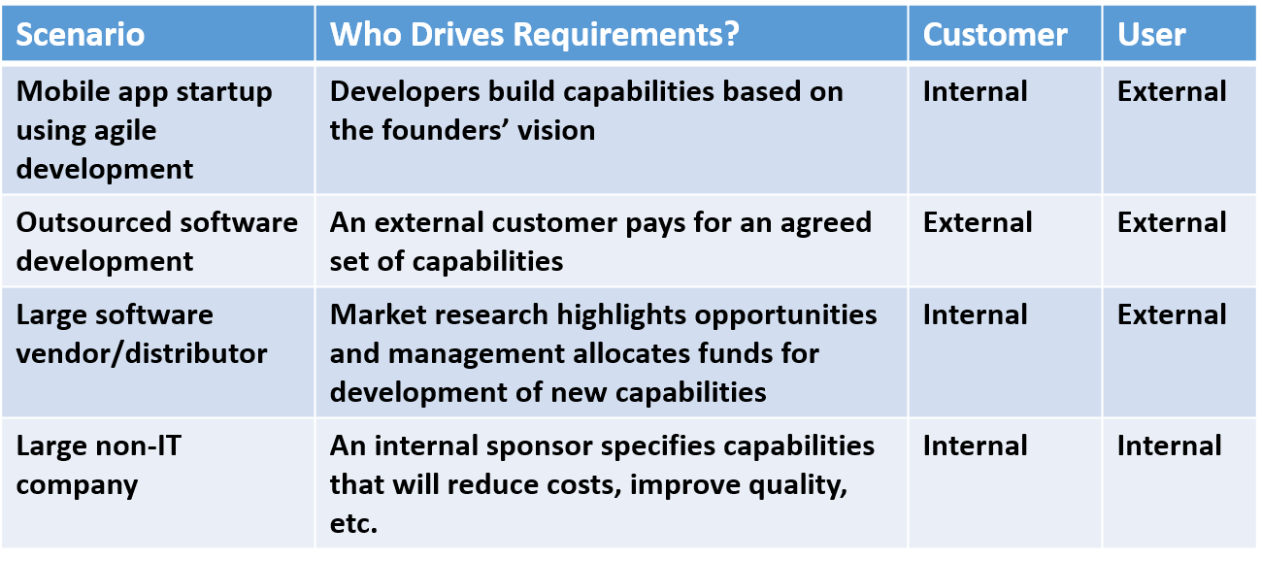
Customers and Users in Different Development Scenarios

Slide 21
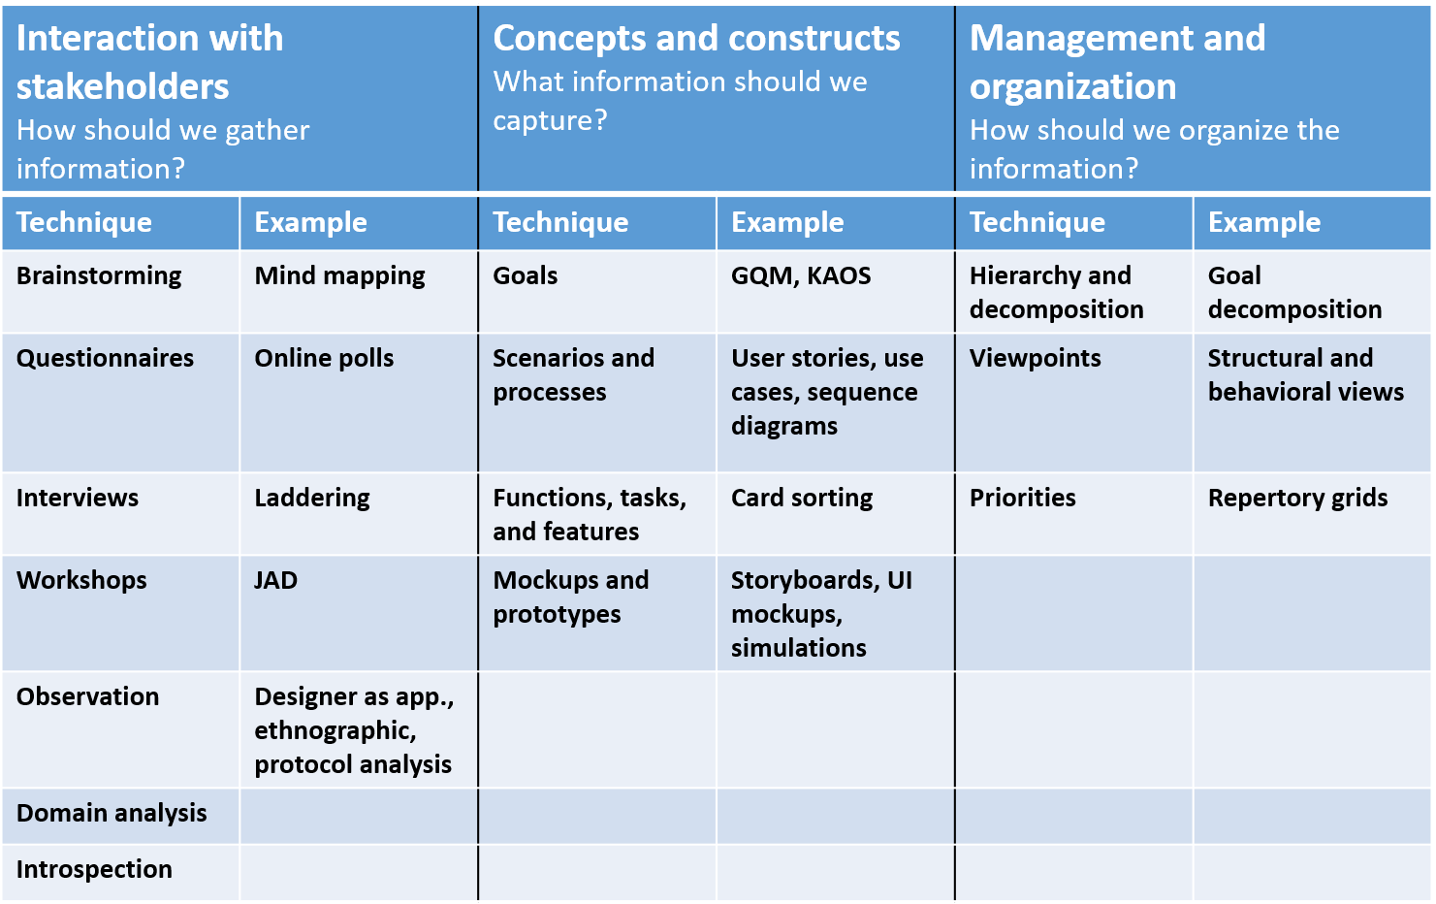
Requirements Elicitation Techniques

Slide 22
Requirements Analysis
Negotiation
Prioritization
Risk management
Quality assurance
Validation and verification

Slide 23
Desirable Properties of Requirements
Unambiguous
Testable
Consistent
Feasible
Understandable
Modifiable
Design agnostic
Traceable

Slide 24
Requirements Defects
Omission
Contradiction
Inadequacy
Ambiguity
Unmeasurable
Noise
Overspecification
Unfeasibility
Unintelligible
Opacity
Poor structuring and organization

Slide 25
Requirements Documentation
Types of documents
Stakeholder Requirements Specification (StRS)
a.k.a. Business Requirements Document (BRD), Business Requirements Specification (BRS)
System Requirements Specification (SyRS)
Software Requirements Specification (SRS)

Slide 26
Requirements Documents
Official statement of what is required of the system developers
May be a binding contract (enforceable by law)
Should include both a definition and a specification of requirements
It is not a design document. As far as possible, it should specify what the system should do rather than how it should do it
There are many documentation formats
There is no best documentation format – it all depends sponsor, on the situation, customer, application domain, etc.

Slide 27
Users of a Requirements Document
Specify the requirements and read them to check that they meet their needs. They specify changes to the requirements.
Customers
Don’t forget lawyers, judges, plaintiffs, juries, district attorneys, arbiters, mediators, etc., who will view the SRS as a legal document in the event of disputes.
Use the requirements document to plan a bid for the system and to plan the system development process.
Managers
Developers
Use the requirements to understand what system is to be developed.
Test engineers
Use the requirements to develop validation tests for the system.
Maintenance engineers
Use the requirements to help understand the system and the relationship between its parts.

Slide 28
Requirements Modeling
Formal
Have a rigorous, mathematical basis
Examples: model checking, first-order logic, object constraint language (OCL)
Informal
Cannot be completely transliterated into a rigorous mathematical notation
Examples: natural language, flowcharts, PowerPoint diagrams
All SRSs will have informal elements
Semi-formal
Combine elements of formality and flexibility
UML, SysML

Slide 29
Modeling Notation Considerations
Expressiveness
Ease-of-use
Maintainability/modifiability
Conciseness
Ambiguity
Use in automated analysis and code generation
Formal verification of correctness and safety

Slide 30
Standardized Languages
Widely used throughout the software and systems engineering community
The Unified Modeling Language (UML) and accompanying Model-Driven Architecture (MDA) is the foremost example of this approach
Widespread success and industrial adoption
Advantages:
Provide a common vocabulary for engineers to exchange ideas and designs
Extensive tool support is available
Most engineers will already be familiar with the language – less training needed
Disadvantages
“Design by committee”
Usually not the most effective way to capture/express domain concepts
Extraneous features
Missing features

Slide 31
Domain-Specific Modeling
Emerging approach with less (but growing) industrial adoption
Customized for a specific domain
Application domains: avionics, health care
Technology domains: agent-based systems, mobile apps
Advantages
Express domain concepts in the most straightforward, intuitive way
Can be customized for the needs of each R&D program
Can be easily modified, evolved, composed, etc.
Disadvantages
Constructing good languages is difficult and may represent a significant investment of resources
Language change and evolution may negatively impact a development project
Engineers need to be trained to use the language correctly

Slide 32
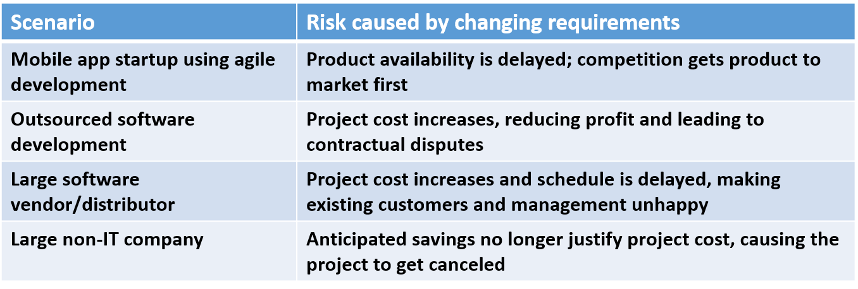
Managing Changing Requirements
Customers can be fickle – you must anticipate this
Changing requirements can lead to:
Increased cost
Delayed schedule
Decreased quality
Changing requirements result in various types of risk

Slide 33
Traceability
Traceability is concerned with the relationships between requirements, their sources and the system design
Source traceability
Links from requirements to stakeholders who proposed these requirements
Requirements traceability
Links between dependent requirements
Design traceability
Links from the requirements to the design

Slide 34
Best Practices for Traceability
Trace for a purpose
Determine which linkages are truly important
Avoid generating extraneous links
Define a suitable trace granularity
e.g., should linkages be at a package, class, or method level?
Support in-place traceability
Provide traceability between artifacts as they reside in their native environments
Use a well-defined project glossary
Create during initial discovery meetings with stakeholders
Use consistently throughout the RE process

Slide 35
Requirements Engineering in Agile Methodologies
Agile methods address one of the biggest challenges in software development: changing requirements.
A major difference between traditional and agile methodologies is in the gathering of requirements.
Requirements engineering approaches for agile methodologies tend to be much more informal.
Some proponents of agile methodologies use requirements engineering practices as a selling point for agile.

Slide 36
Characteristics of Agile Methods
Informal requirements specifications (user stories, backlog)
Fixed duration development increments (iteration, sprint)
Short daily meetings (stand up meeting, scrum)
Progress metrics (task estimation, project velocity)
Examples: XP, Scrum

Slide 37
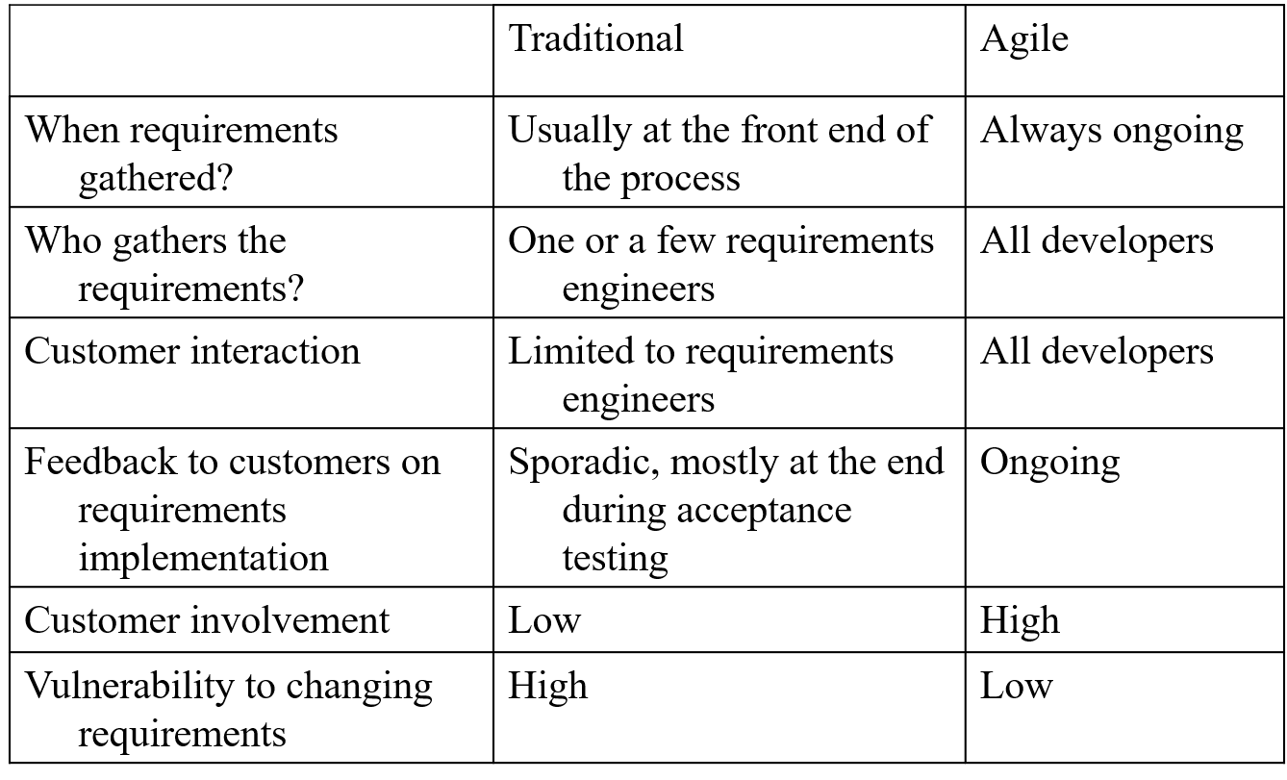
Requirements Engineering: Agile vs. Traditional

Slide 38
User Stories and Agile RE
User stories are the most basic unit of requirements in most agile methodologies
User stories are written by the customer
Each user story represents a feature desired by the customer
Formal requirements and use cases are derived from the user stories by the software engineering team as needed

Slide 39
User Story Components
Title – a short handle for the story; present tense verb in active voice is desirable
Acceptance test – a unique identifier that will be the name of a method to test the story
Priority – based on the prioritization scheme adopted
Story points – estimated time to implement (e.g., 1-3 days in XP)
Description – one to three sentences describing the story

Slide 40
Agile Requirements Best Practices
Stakeholders actively participate
Adopt stakeholder terminology
Frequent, personal interaction
Implement requirements, do not document them
Express requirements as features
Treat requirements like a prioritized stack
Adopt inclusive models
Create platform independent requirements
Use user stories
Smaller is better
Frequent delivery of software

Slide 41
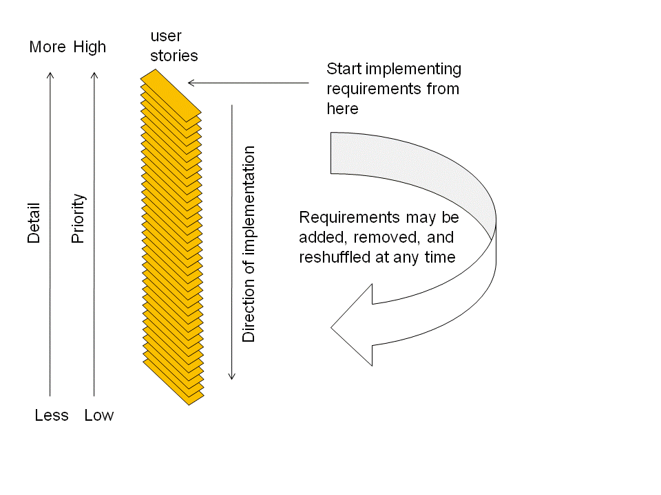
Agile Requirements Change Management

Slide 42
Challenges for RE and Agile Methodologies
Dealing with non-functional requirements
Because they are not always apparent when dealing with requirements functionally only
User stories can be augmented with appropriate NFRs
Customer interaction is strong – but mostly through prototyping
Using various interviewing techniques would be desirable
Validation is strong through testing, but verification is weak
Using formal methods could strengthen agile RE
Large-scale projects
Teams are limited in size

Slide 43
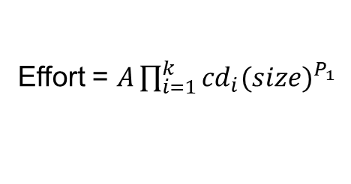
COCOMO
Estimates the person-months required to develop a system based on source lines of code (SLOC)
Only SLOC that is part of the product is included
Excludes test drivers, support software, auto-generated code
Uses logical SLOC (excludes comments, whitespace, declarations, etc.)
Estimate is computed using a parametric model
A depends on the extent to which the hardware and software are independent
P is computed from scale drivers
cd are cost drivers
Effort = $A\prod_{i=1}^{k}{{cd}_{i}{(size)}^{P_{1}}}$

Slide 44
Scale Drivers
Precedentedness
Development Flexibility
Architecture / Risk Resolution
Team Cohesion
Process Maturity

Slide 45
Cost Drivers (1/2)
Product
Required Software Reliability
Database Size
Product Complexity
Developed for Reusability
Documentation Match to Lifecycle Needs
Personnel
Analyst Capability
Programmer Capability
Personnel Continuity
Application Experience
Platform Experience
Language and Toolset Experience

Slide 46
Cost Drivers (2/2)
Platform
Time Constraint
Storage Constraint
Platform Volatility
Project
Use of Software Tools
Multisite Development
Required Development Schedule

Slide 47
COCOMO Calibration
Scale and cost drivers are assigned values (Very Low, Low, Nominal, High, Very High, Extra High)
Coefficients are computed for each value using data from many real software projects
Examples:
Very High Complexity = cost driver of 1.34
Low Language & Tools Experience = cost driver of 1.09
All Nominal values = cost driver of 1

Slide 48
Estimating SLOC (1/2)
During requirements analysis, it is not known how many SLOC are needed
Function points, feature points, and use-case points can be used to derive SLOC estimates
Function points
External inputs: data that crosses the boundary from outside to inside
External outputs: data that crosses the boundary from inside to outside
User queries: input and output components that result in data retrieval from one or more internal logical files and external interface files
Internal logical files: a user identifiable group of logically related data that resides entirely within the applications boundary and is maintained through external inputs
External interfaces: logically related data that resides entirely outside the application and is maintained by another application

Slide 49
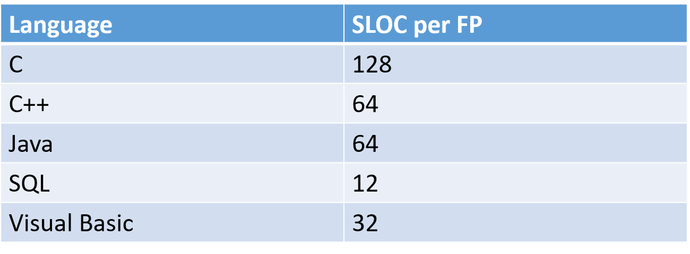
Estimating SLOC (2/2)

Slide 50
Discussion: How Are Requirements Used in Forensics?

